Slide 1
Integrated surveillance of AMR (with a focus on the environment)
Heike Schmitt
Hetty Blaak, Ana Maria de Roda Husman
National Institute for Public Health and the Environment
WHO CC on Risk Assessment of Pathogens in Food and Water
Delft University of Technology / Wetsus

Slide 2





Integrated surveillance
Is required as AMR is a One Health problem
Public health surveillance is “the ongoing, systematic collection, analysis, and interpretation of health-related data essential to planning, implementation, and evaluation of public health practice.”
Surveillance is data for action
CDC / Gregg: Field Epidemiology

Slide 3
Goals – integrated surveillance
1. Evaluating trends in AMR or AMU
Provide information on human exposure to AMR through relevant matrices
2. Monitoring the emergence of new forms of antimicrobial resistance
Provide information on human exposure to AMR through relevant matrices
3. Analysing the effectiveness of interventions
Use presence of AMR in environmental matrices as proxy for prevalence of AMR in the population
4. Contributing to data on human exposure to AMR
Use presence of AMR in environmental matrices as proxy for prevalence of AMR in the population
These have implications for the setup of surveillance
Notes:
Sources of emission ➔ interventions

Slide 4
International examples of integrated surveillance
1

Slide 5
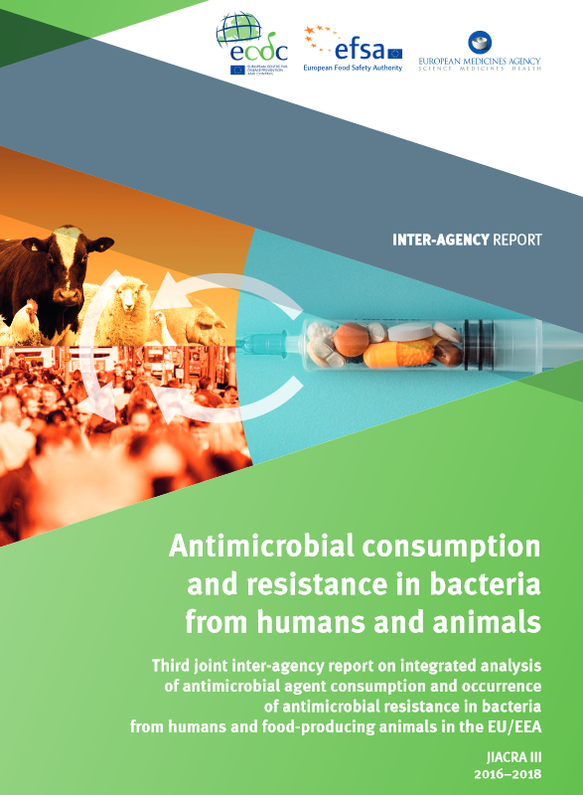
JIACRA reports: integration through data analysis
Goal: analyse the relation between the consumption of antimicrobials by humans and animals and the occurrence of antimicrobial resistance.

Slide 6
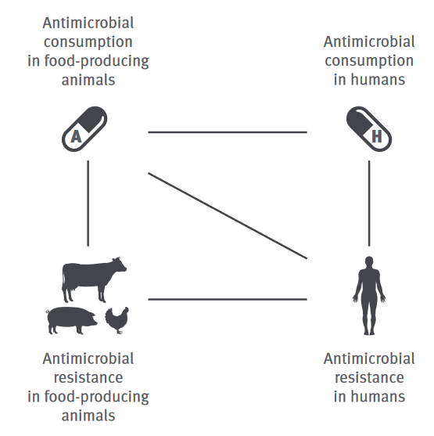
JIACRA data and analysis methods
European Centre for Disease Prevention and Control (ECDC): antibiotic consumption (AMC) in humans (ESAC-Net)
ECDC: AMR in bacterial isolates from human infection (EARS-Net, FWD-Net)
European Food Safety Authority (EFSA): AMR in bacteria from food-producing animals (ESVAC)
European Medicines Agency (EMA): AMC in food-producing animals.

Slide 7
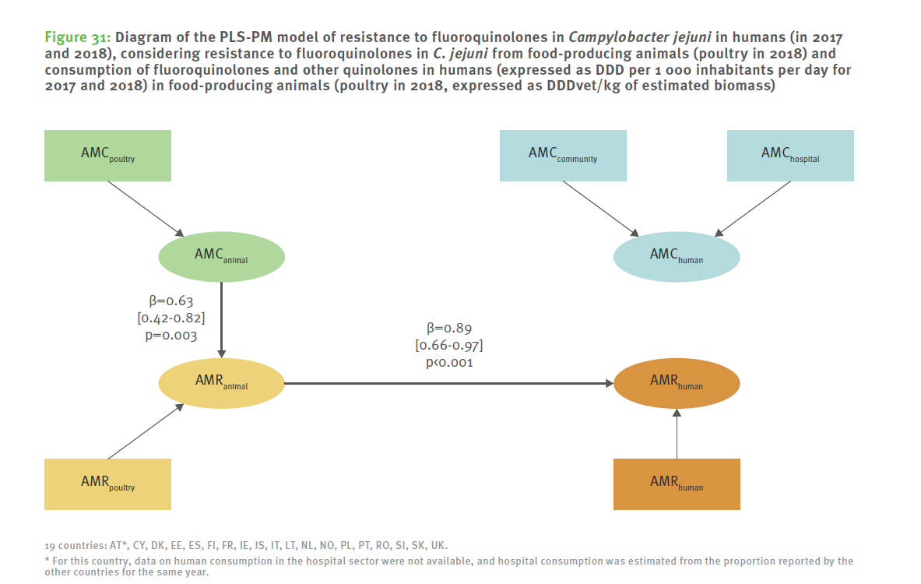
JIACRA outcome
For C. jejuni: significant relation between resistance in poultry and resistance in humans

Slide 8
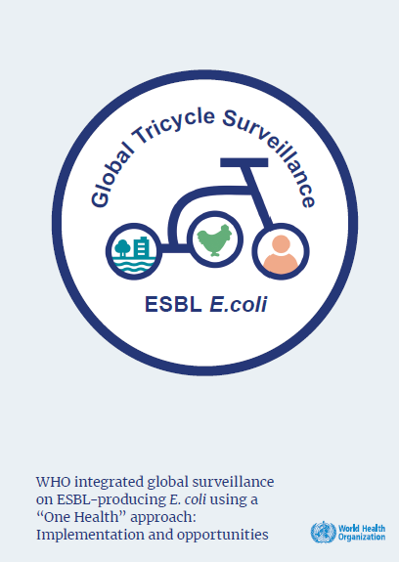
WHO integrated surveillance (Tricycle): integration at level of sampling and bacterial endpoint
To provide Member States with a common, simplified, and integrated multisectoral surveillance system to detect and estimate the prevalence of an indicator with a specific resistance mechanism, ESBL producing E. coli, in three sectors.

Slide 9
Principles of Tricycle protocol
Simple
  One indicator: Extended Spectrum Beta Lactamase (ESBL) producing Escherichia coli
Feasible
  Implementation possible in many countries
  Limited resources (laboratory, training)
  Data management (WHONET)
Standardized
  Standard laboratory methodology

Slide 10


Principles of Tricycle protocol
Hospital level: proportion of ESBL-Ec strains among E. coli isolated from bloodstream infections
Community level: prevalence of ESBL-Ec in pregnant women
Pollution of water from human and animal wastewater
Water at ‘point of contact’: river upstream and downstream from cities
Single target animal: poultry
Frequently consumed
Samples are readily available

Slide 11
Why ESBL producing E. coli?
Resistance to Critically Important Antimicrobials (global public health relevance)
Variable prevalence among farm animals, present in the environment; (One Health relevance)
Variations in prevalence between countries, and in time. AMU Interventions resulted in a decrease in ESBL-Ec occurrence (data for action)
Other criteria for endpoints
Sector relevance
Pandemic preparedness (early warning for emerging forms of AMR)
Practical issues (measurability)

Slide 12
Implementation structure

Slide 13
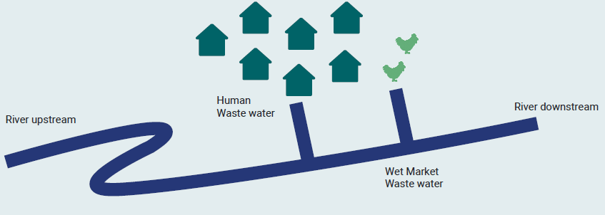
Tricycle env. sampling: sources and exposure
Human wastewater (urban community / WWTP)
Animal wastewater (wet market, slaughterhouse)
River upstream (city background)
River downstream (city influence)
Sources
Exposure
Satellite extensions:
Hospital wastewater
Drinking water

Slide 14
Current international activities on integrated surveillance
2

Slide 15
Quadripartite Technical Group on Integrated Surveillance
Aim:
Provide advice and guidance on the development of global, regional and country-level systems for integrated surveillance of antimicrobial resistance and antimicrobial use
Organisation:
WHO / FAO / WOAH / UN secretariat and input
Expert group
First meeting 1/2023, plan of action for first 2 years

Slide 16
Quadripartite Technical Group on Integrated Surveillance
Roles and Responsibilities:
Review and refine the definition of Integrated Surveillance
Review current approaches and guidance on integrated surveillance
Develop a framework for integrated surveillance
Advise on microbial indicators, and role of technologies and laboratory and diagnostic capability

Slide 17
JAMRAI-2
Joint Action Antimicrobial Resistance and Healthcare-Associated Infections 2
Aim:
Support Member States/Associated Countries in their efforts to develop and update their National Action Plan (NAP) on AMR.
In a One Health framework
Organisation:
University of Limoges
129 participating institutions
1/2024, 4 years

Slide 18
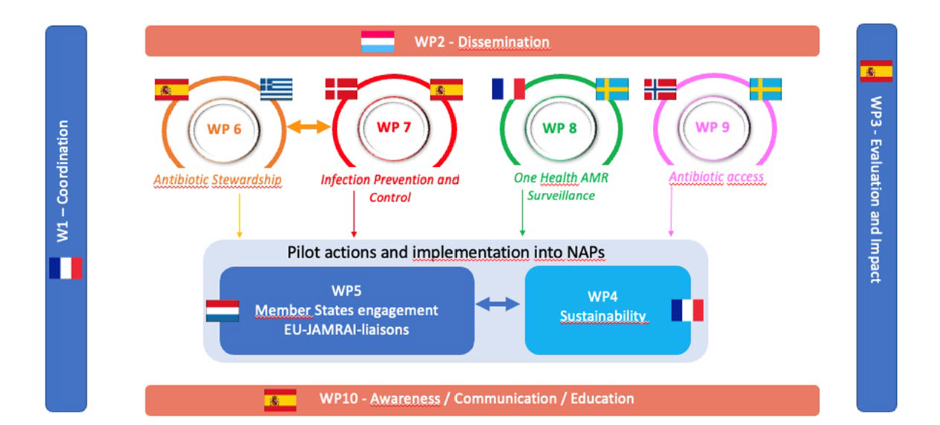
JAMRAI-2
Technical WP aligned with WHO Global Action Plan:
Antibiotic stewardship
IPC
One Health surveillance
Antibiotic access
Awareness raising

Slide 19
Environmental surveillance in the Netherlands
3

Slide 20

Sources and spread of AMR
Presence of AMR in hospital wastewater
RIVM report 2018-0114
Humans
Conclusion:
Human wastewater and animal manure are major sources of resistant bacteria, with comparable contribution
Within human wastewater, both treated effluent and raw effluents (overflows) important
Hospitals no major source
Studies often focusing on ESBL E. coli but also antibiotics, resistance genes
Special populations
AMR in overflows
STOWA Rioned rapport 2018-11
Hospitals
General population
AMR in wastewater
RIVM report 2017-0058
AMR in animal manure
RIVM report 2019-0112
AMR in surface water under influence of agriculture
RIVM report 2019-0152
Animals
Environment

Slide 21
Wastewater epidemiology / surveillance
Humans
Conclusion:
Wastewater analysis can inform about presence of ‘rare’ MDRO
Especially suited when there is little information about community carriage, and for ‘rare’ pathogens
Special populations
Hospitals
AMR in city districts
RIVM report 2019-0199
Analysis of slaughterhouse wastewater as surveillance tool
RIVM report 2020-0166
AMR wastewater surveillance
RIVM report 2017-0058
RIVM report 2022-0008
General population
Animals
Environment

Slide 22
Conclusions
Integrated surveillance has several purposes which affects implementation
Integrated surveillance can be applied at different levels and is context-dependent
International examples exist
Further guidance is currently being developed
Acknowledgements:
  RIVM zoonoses and environmental microbiology
  Dutch Waterboards
  Dutch Ministry of Health, Welfare and Sport
  JPI AMR TRIuMPH, JPI AMR WAWES, Dutch Organisation for Health Research and Development (ZonMw)

Slide 23
Conclusions
Goal of environmental surveillance helps determining sampling strategy
  Exposure: surface water / drinking water / specific populations at risk
  Emission sources: treated human wastewater (WWTP)
  Circulation in the population: raw human wastewater
  Effect of interventions: close to where interventions are taken
Goal and integration with other sectors helps determining endpoints
  Exposure: priority pathogens
  Emission sources: range of possible endpoints
  Circulation in the population: priority or emerging resistance pathogens, or genetic determinants
Difficult to capture through environmental surveillance:
  Mobilisation of AMR from the environment
  Fate of AMR in the environment
  These rather require metagenomic approaches than culturing

Slide 25
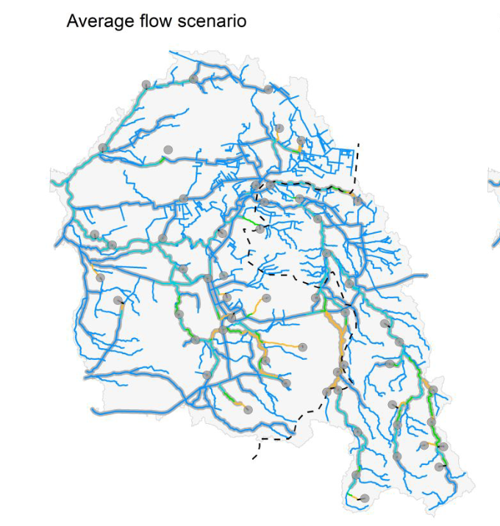
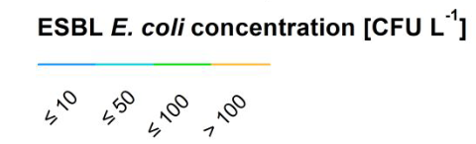
AMR example: ESBL E. coli in a catchment
Sampling combined with water catchment modelling
This enables to evaluate concentrations across whole catchments
Wastewater treatment plants contribute 96% of all ESBL E. coli
Calculation of intake of ESBL E. coli during recreation: ~30 CFU per swimming event at max
Heijnsbergen (2022) Environmental Science & Technology

Slide 26
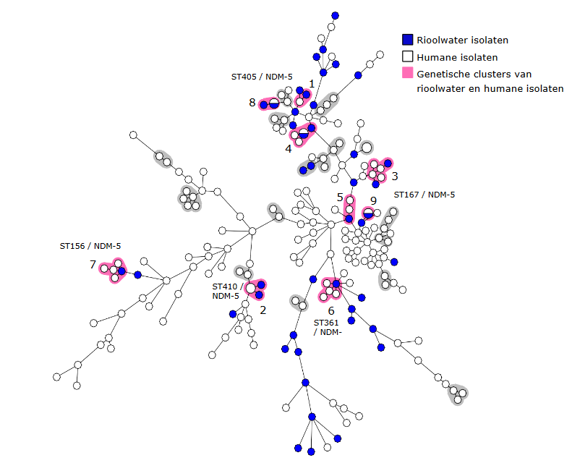
wgMLST analysis human and WWTP isolates
NDM and KPC – positive isolates
Clusters between wastewater isolates and human isolates found
Clusters of wastewater and human isolates were found in 4 out of 28 known carriers that were related to a sampled wwtp in time and location
RIVM report 2022-0247
Notes:
Human isolates from the national CPE surveillance programme 2018 – now (n=414)- clinically ill or travel history
Wastewater isolates from 2020/2021 surveillance (n=72)

Slide 27
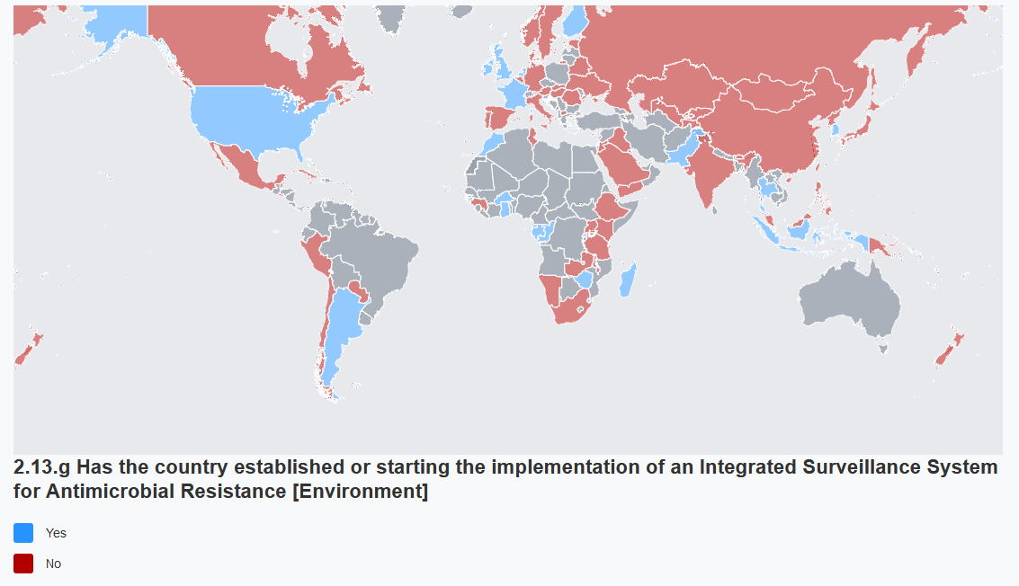
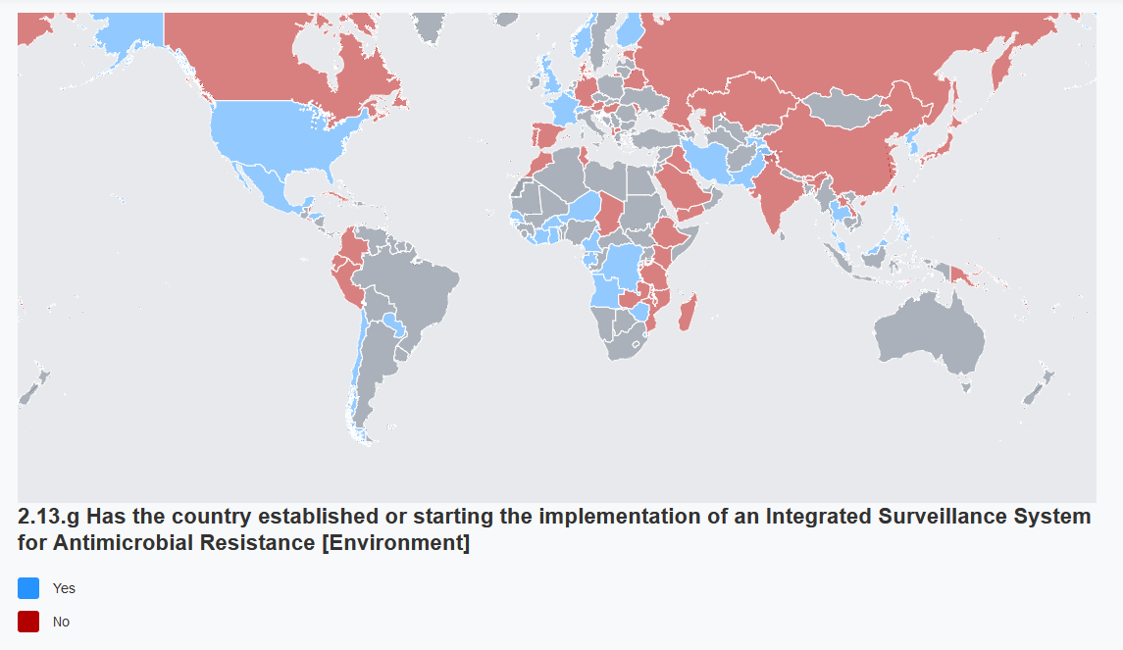
Env AMR surveillance in National Action Plans
Examples:
CPE in wastewater (NL)
Antibiotics in the water cycle (Switzerland)
Antibiotics and AMR in surface water (USA)
Swiss Antibiotic Resistance Report 2020
NARMS strategic plan 2021-2025, objective 1.2
Notes:
Combating antimicrobial resistance in Singapore. Qualitative study exploring the policy context, challenges and proposed strategies
https://www.fda.gov/media/79976/download?attachment

