Slide 1
International cooperation in the Baltic Region
- a Swedish perspective
Cross-sectoral One Health Conference on Antimicrobial Resistance
Riga, 6 Dec 2023
Dr Malin Grape
Ambassador on Antimicrobial Resistance
Ministry of Health and Social Affairs

Slide 2
Long-standing cooperation
2004 BALTICCARE – The Baltic Network for Infection Control, Containment of Antibiotic Resistance, and Healthcare Epidemiology
2009 BARN – Baltic Antibiotic Resistance collaborative Network 2012
  Grass-root initiative
  170 members, from Belarus, Estonia, Georgia, Latvia, Lithuania, Moldova, Poland, Russia, Sweden and Ukraine
  multidisciplinary network: Health care professionals – all levels, Microbiologists, Infection control specialists, Pharmacists, Governmental officers
Notes:
We have a long and positive experience of working with the countries in the Baltic region in the field of AMR and IPC.
The initial formal and funded collaboration was made almost 20 years ago in 2004 and called BALTICCARE (The Baltic Network for Infection Control, Containment of Antibiotic Resistance, and Healthcare Epidemiology).
In 2012 (2009) it turned into the BARN Network (Baltic Antibiotic Resistance collaborative Network) coordinated by the Public Health Agency of Sweden.
At the most it had 170 members, from Belarus, Estonia, Georgia, Latvia, Lithuania, Moldova, Poland, Russia, Sweden and Ukraine. It was a multidisciplinary network: Health care personnel – all levels, Microbiologists, Infection control specialists, Pharmacists, Governmental workers just to name a few. It was built upon grass root-initiatives and served as a platform for inspiration and knowledge exchange. The network was highly appreciated and had impact on both policy and practice in the region.
o A number of sub-projects were initiated from within the network, (ge exempel på några sådana från andra ppt:n?)
What we saw as a natural/further continuation/development of BARN was to focus a little bit more on the spread of knowledge to/inclusion of Ukraine, Moldova, Georgia and Belarus. In that process the Baltic countries were excellent partners functioning as a bridge.

Slide 3


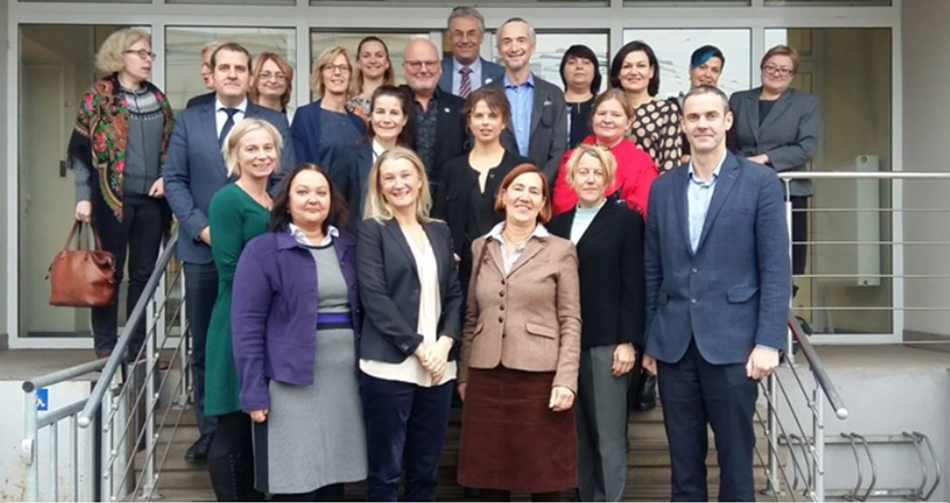

LATOHOP
Latvia One Health One Plan– 2019-2022
  Request from Latvia to EU Commission – Sweden assigned
  Support and enable implementation of National Action Plan on AMR
Photo: PHA Sweden
Notes:
Latvia applied to EU for support with the purpose of enabling national authorities to implement the One Health action plan
EU contacted several countries,
the assignment went to Sweden in 2019
Funded by the European Commission through the Directorate-General for Structural Reform Support (DG REFORM) Technical Support Instrument (TSI)
One Health => the Swedish Board of Agriculture (SBA) and the Public Health Agency of Sweden (PHAS)
Internal analysis of the AMR situation in Latvia- basis for the project plan including three overarching outcomes
These are the utcomes were formulated that would enable national authorities in Latvia to have the full capacity to implement the One Health action plan (på sliden)
The project was affected by the pandemic, but managed to adjust and follow through on the activities.

Slide 4
LATOHOP
Outcome 1:
The Centre for Disease Prevention and Control and Food and Veterinary Service are empowered to implement the One Health National Action Plan.
Outcome 2:
Human and animal health professionals and animal farmers are provided with skills and tools for prudent use of antibiotics as a mean to prevent and contain AMR.
Outcome 3:
An intersectoral coordinating mechanism (ICM) is put in place to support information sharing and collaboration between sectors on various aspects of AMR among relevant professionals.

Slide 5

Results of the project
Outcome 1:
Latvia initiated process of updating the National Action Plan on AMR
Prioritized activities using the methods introduced
A method for implementation was introduced

Slide 6
Results of the project
Outcome 2:
Tools and knowledge how to prevent infections as well as responsible use of antibiotics were developed and piloted
Guidelines
Digital learning platform on antibiotic ward rounds in hospitals

Slide 7
Results of the project
Outcome 3:
Shared experience and working methods from the Swedish ICM
Road map and Terms of Reference for the Latvian ICM developed.
Kick-off meeting for the ICM in Riga in April

Slide 8
Outcomes and outputs
Outcome 1: The Centre for Disease Prevention and Control and Food and Veterinary Service are empowered to implement the One Health National Action Plan.
Output 1: Sustainability plan for continued work on implementing the One Health NAP
Outcome 2: Human and animal health professionals and animal farmers are provided with skills and tools for prudent use of antibiotics as a mean to prevent and contain AMR.
Output 2: Farm Toolbox and Hospital Toolbox
Outcome 3: An intersectoral coordinating mechanism (ICM) is put in place to support information sharing and collaboration between sectors on various aspects of AMR among relevant professionals.
Output 3: A roadmap on increased national, intersectoral communication in Latvia.
Notes:
These are the utcomes were formulated that would enable national authorities in Latvia to have the full capacity to implement the One Health action plan

Slide 9

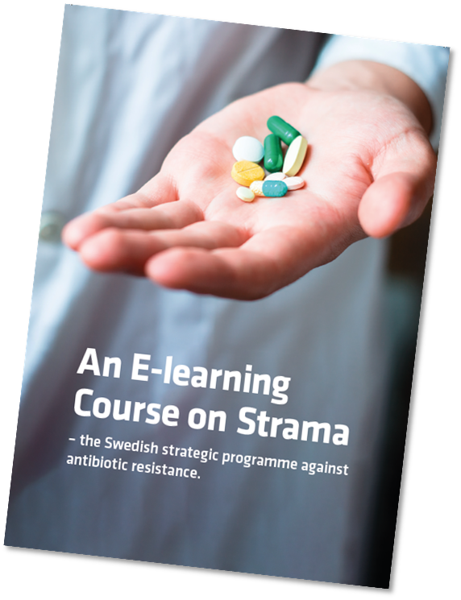
BALTOHOP
Building on LATOHOP – same overaching outcomes
Funded by the Nordic Council of Ministers through NordForsk – 2023-2025
Estonia, Latvia, Lithuania, Denmark, Norway and Sweden
Outcome 2: piloting the Strama e-learning module
Latvian experience important
Notes:
Larger base of ideas experieces and experties
Build stronger networks in the region
Difference in Outcome 2: piloting the Strama e-learning module together with workshops and country visits

Slide 10

NDPHS- Northern Dimension Partnership in Public Health and Social Well-being
EUSBSR PA: Health
Chair of AMR-EG and PHC-EG
Resulted in separately funded projects
NoDARS and NorthernGLASS
Ministerial Partnership Annual Conference AMR side-event 15-16 January 2024
Notes:
Sweden is also an active memeber of the Northern Dimension Partnership in Public Health and Social Well-being (NDPHS)
The policy area coordinator for Health within the EU Strategy for the Baltic Sea Region. Sweden is chairing the Expert Group on AMR as well as the Expert Group on Primary Health Care.
A number of project have been the result of the work in the AMR-EG, for example NorthernGLASS (Early implementation of the WHO Global Antimicrobial Resistance Surveillance System GLASS) NoDARS (6 länder (Sverige, Lettland, Finland, Ryssland, Tyskland, Polen) inom NDPHS som gjorde en gemensam studie på resistens i samhället i vardera land. Det som undersöktes var ESBL bärarskap och resistensmönster hos okomplicerad UVI för E.coli.)

Slide 11
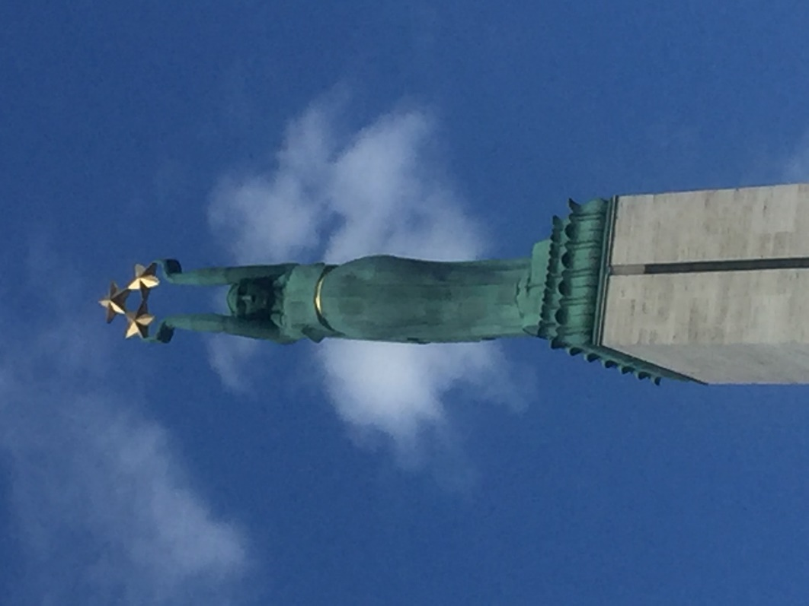
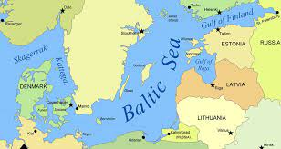
Thank you!
Photo: Gunilla Skoog Ståhlgren
Notes:
With the current threat to our region it is more important than ever to work together and form alliances to meet both current and future needs within the field of AMR and IPC.
We have a many similarities and a relatively good situation regarding society, health care and AMR within our region today, but if we want to keep it that way we have to make sure that we do not relax, that we stay on our toes keep working and being innovative to tackle AMR.
Detta är en alternativ fortsättning efter today, ovan: (the jobs/functions/key positions are resourced and that the conditions to educate and attract the right people to those functions are created. From health care workers to ministerial personnel. This is the ultimate preventive work!)
We look forward to at least 20 more years of collaboration!

