Slide 1

One Health European Joint Programme (EJP):
From Science to Policy
Annemarie Käsbohrer, BfR
WP5 Science to Policy Translation
Riga 7 December 2023

Slide 2



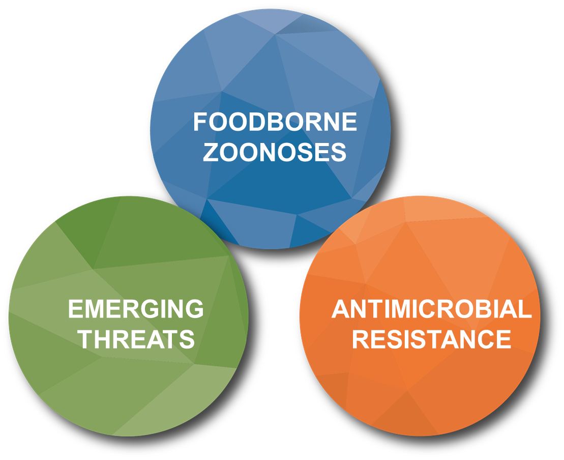

One Health EJP: key facts
5 YEAR PROJECT
European Joint Programme Co-fund
under Horizon 2020, project started in
January 2018 until September 2023.
    Coordination Team: ANSES, France
    Scientific Coordinator: Sciensano, Belgium.
    44 partners across Europe PH/AH/FS
    Partners have received mandate from
    authorities.
    Total cost €90M, 50% EU co-funded.
    24 Joint Research Projects and
    7 Joint Integrative Projects.
    Education & Training activities:
      17 PhD students, 40+ Short Term Missions, Workshops,
      Summer Schools and Continuing Professional Development modules.
HORIZON 2020
50% CO-FUNDED
€ 90 MILLION
44 PARTNERS
ACROSS EUROPE

Slide 3
HUMANS
Coordi-nation & Communi-cation
Joint Research Projects
One Health EJP
Education& Training
Strategic Research Agenda
Projects
Sustain-ability
Joint Integrative Projects
Science to Policy
Science to Policy
Year 1 to 5
ANIMALS FOOD
International stakeholders: ECDC, EFSA, …
National stakeholders: Ministries, local Food Agencies

Slide 4
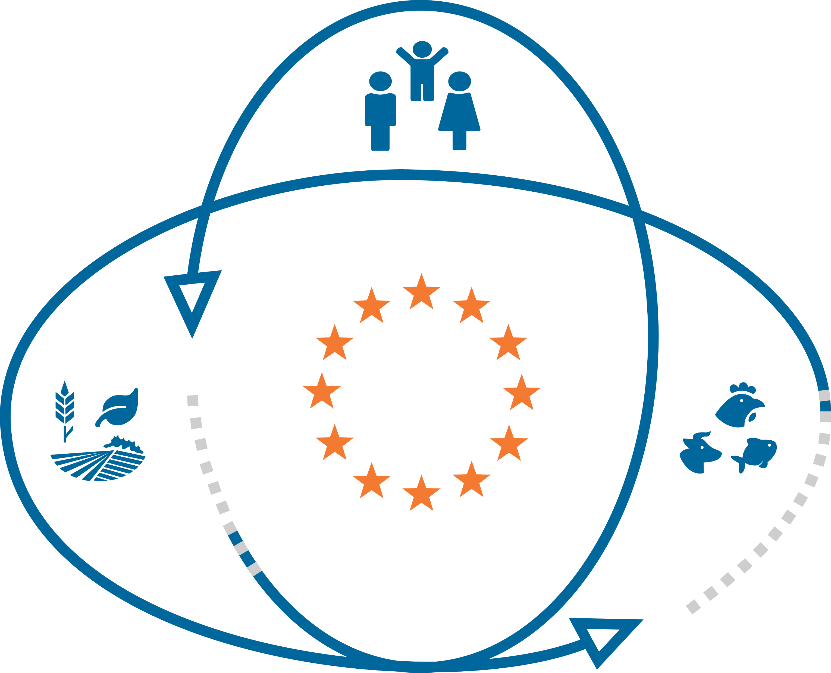

The integrative projects

Slide 5







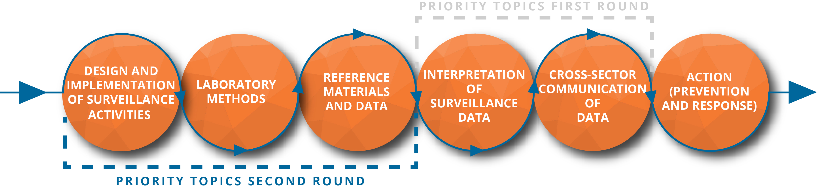



Joint Integrative Projects (JIPs)
Simulation exercise
Notes:
prevention, preparedness, detection and response
Regarding the integrative projects, the topics follow the steps for setting up surveillance programmes, which was mentioned before. In the two calls that the OHEJP organised, projects in 5 of the 6 steps heve been launched.
ORION – 12 partners, 7 countries
COHESIVE – 15 partners, 9 countries
CARE – 19 partners, 11 countries
OH-HARMONY CAP – 17 partners, 14 countries
MATRIX – 18 partners, 13 countries
COVRIN – 20 partners, 14 countries
OHEJP Exercise, SimEx – 20 partners, 11 countries
Potential new integrative activities to fill the gap for the missing JIP topic were presented and discussed at PMT meetings during 2019.
Decision at PMT meeting January 2020 → WP4 to draft a detailed proposition concerning the organisation of a simulation exercise.
In March 2020 SSB agreed to reallocate budget for two additional activities, the COVID-19 project COVRIN and the Simulation Exercise.
Budget available in January 2021. Project leader recruited, started in April.
Project team recruited and the project started in September 2021.

Slide 6

JIPs: Strengthening the EU capacity
The joint EU capacity is a function of each member state’s capacity.
JIPs are expected to make their developments accessible to all partners and ensure there is transfer of skills and knowledge and promote harmonised approaches whereever it is relevant.
Impact: JIPs will serve to strengthen the scientific capacity within the EJP, as well as the future prevention, preparedness, detection and response of the EU to foodborne and other emerging threats across human-animal-food safety-environmental sectors.
The implementation is up to the member states and potential users.

Slide 7
The research projects

Slide 8

Joint Integrative Projects | Integrative Strategy Matrix | Joint Research Projects
 |  | Foodborne Zoonoses | AMR | Emerging Threats
MATRIX | Design and implementation of surveillance activities | AIR-SAMPLE, NOVA
OH-HARMONY-CAP | Laboratory methods | METASTAVA | IMPART, FARMED, WORLDCOM | TOX-Detect, MAD-Vir, TELE-Vir, IDEMBRU, MEmE, PARADISE
CARE | Reference material and data | LISTADAPT, MedVetKlebs
ORION, COVRIN | Interpretation of surveillance data | ADONIS, BeONE, DISCoVeR, TOXOSOURCES | ARDIG, FULL-FORCE, FED-AMR, RADAR
COHESIVE | Cross-sector communication of data
Simulation Exercise | Action (prevention & response) | MoMIR-PPC, BIOPIGEE
Notes:
This a rather artificial allocation over the domains / ‘preparedness’ steps of the ISM: various JRP can be placed in more than one cell.

Slide 9

Outcomes and expected impact
  Surveillance
    Sampling techniques, assessment of surveillance, syndromic surveillance, recommendations.
  Laboratory techniques, incl. reference material
    Metagenomics, bioinformatics, microarray, on-site / Point-of-Incidence (LAMP, ONT, etc.), ELISA and serological tests,
    mass-spectrophotometry
  Data bases & data analysis, interpretation of data
    Samples and strains, sequences, MALDI-ToF, modelling
    Exposure (and food purchase data)
  Cross-sector communication
    Source attribution
  Action (prevention, response)
    Pre- & probiotics, biosecurity

Slide 10
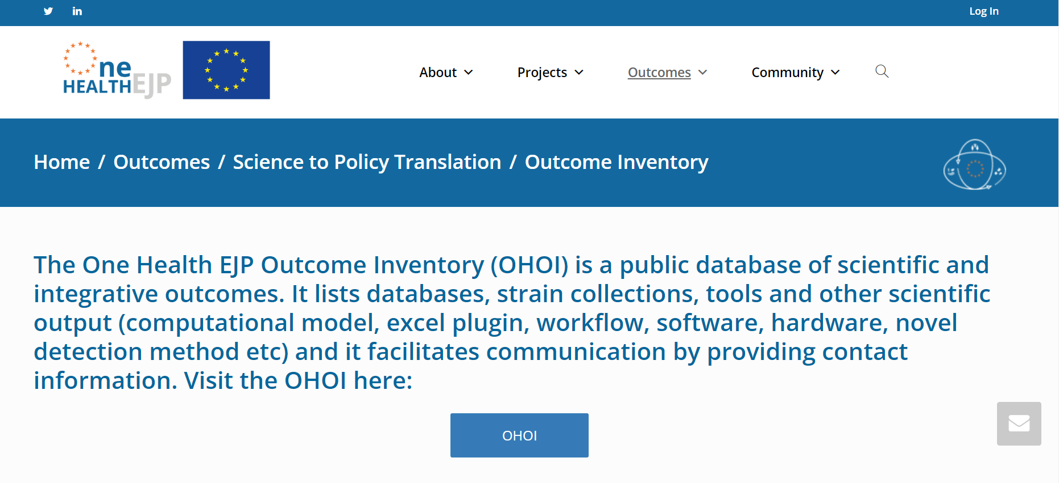
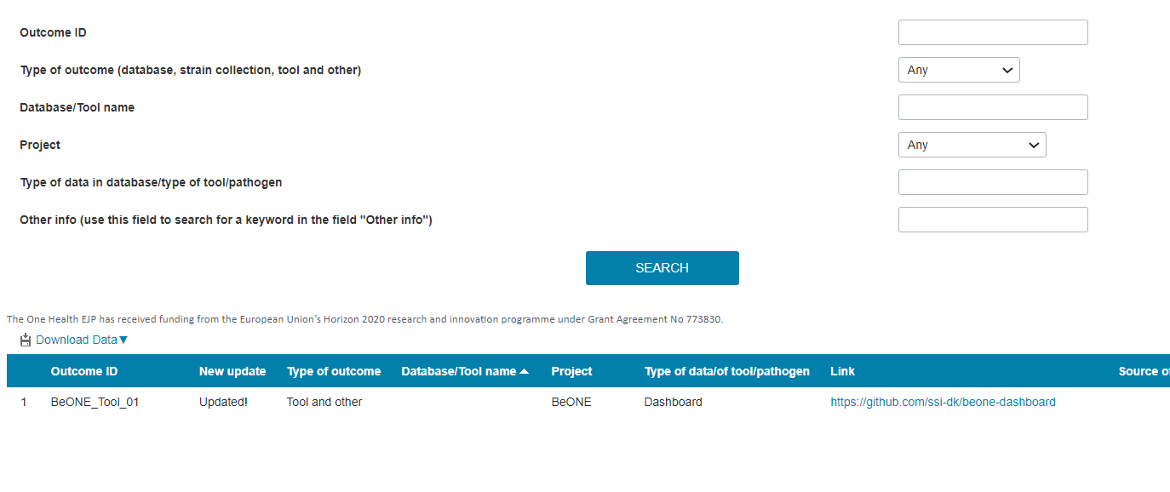
One Health EJP Outcome Inventory (link)
Public database of scientific and integrative outcomes: available on the OHEJP website.
More than 190 entries.
Databases, strain collections, tools and other scientific outputs (computational model, excel plugin, workflow, software, hardware, novel detection method etc.).
Facilitates communication by providing contact information, and thus impact.
Main features
  Open access
  Easy to use: search by keywords
  Regular updates
  Entries validated by projects coordinators
WP5 slide 9
Notes:
The OHOI is advertised on newsletters, at meetings, at international conferences, on the One Health EJP website, and through other means (for example it was published in the introduction of MATRIX/ORION OHS Codex/KIP).

Slide 11
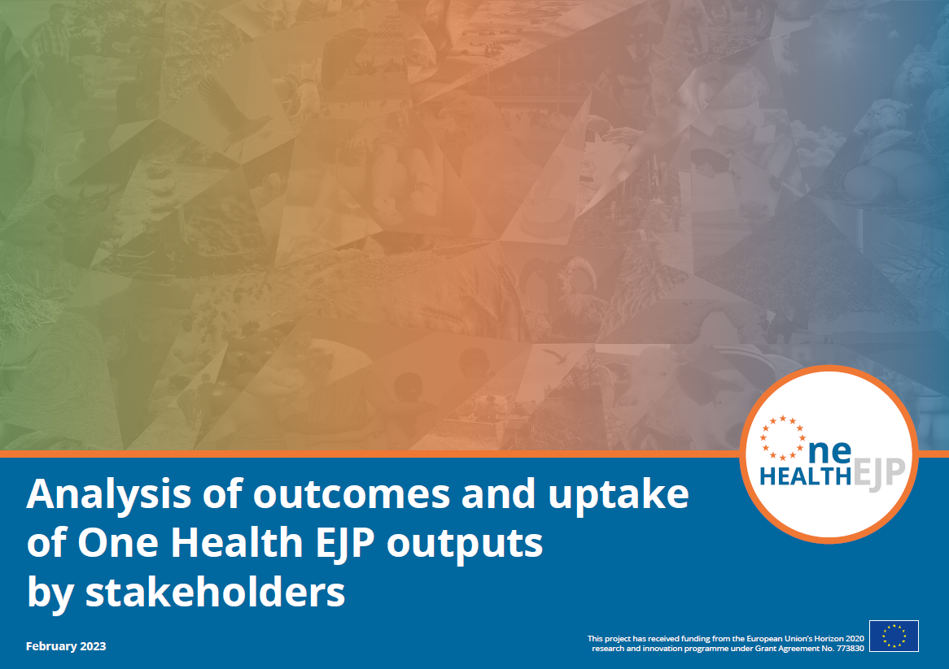
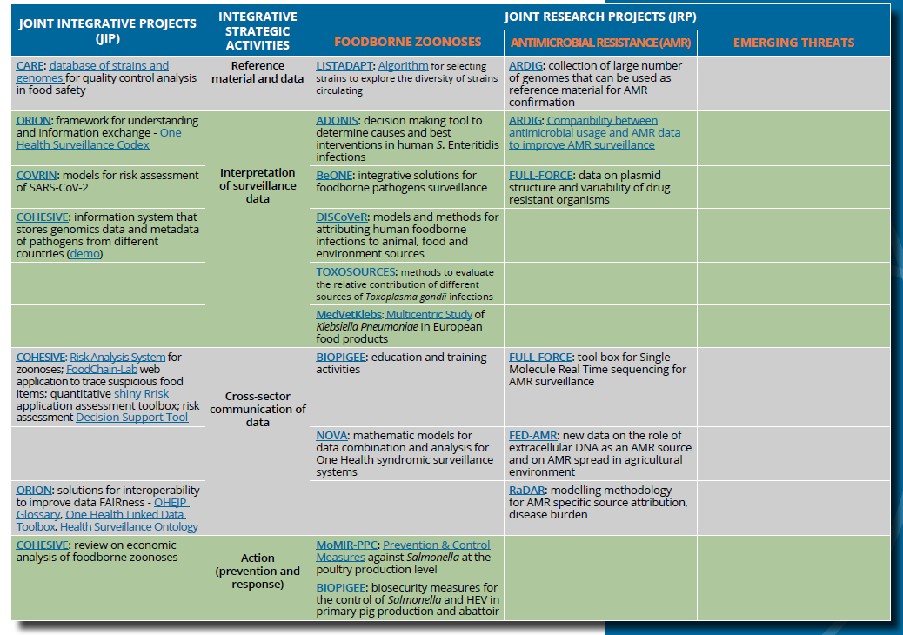
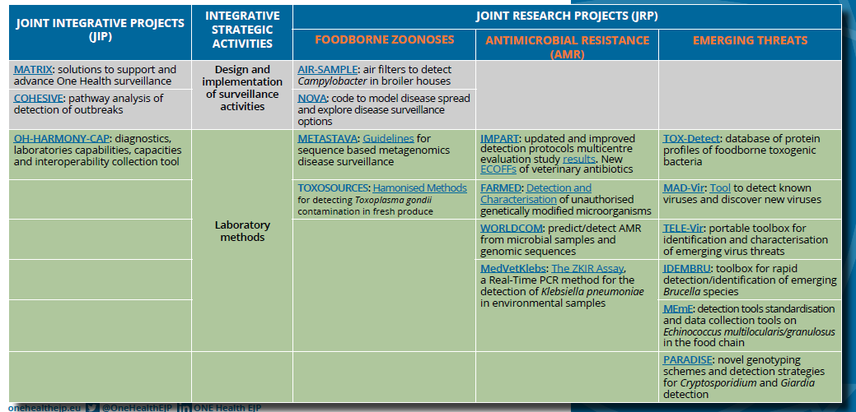
Outcomes for uptake by stakeholders
Ensure that the main scientific outputs, protocols, databases, and other strategic integration activities will be sustainable beyond the lifetime of the project
List of outcomes resulting from One Health EJP JIP and JRP that will address some of the needs of principal stakeholders, namely, ECDC, EFSA, DG-HEALTH and DG-AGRI and beyond.
Notes:
An objective of the One Health EJP is to ensure that the EJP main scientific outputs, protocols, databases, and other strategic integration activities will be sustainable beyond the lifetime of the project. To address this objective, WP7 worked together with WP1, WP3, WP4 and WP5 in collaboration with the project leaders, to produce a list of outcomes resulting from One Health EJP JIPs and JRPs that will address some of the needs of principal stakeholders, namely, ECDC, EFSA, DG-HEALTH and DG-AGRI. This list of outcomes describes protocols, databases and other tools and solutions expected to contribute to the work of not only the four named stakeholders, but also others. A shortened version of this list is available below, while the full list is available in part 3 of D7.1 Analysis of outcomes and uptake of EJP’s outputs by stakeholders.

Slide 12
Training and education

Slide 13

Who should OH education focus on?
Public
Farmers
Health professionals (Vets, doctors)
Researchers
Policy makers
Stakeholders
Funders
Regulators
Educators and students (Schools etc.)

Slide 14


OHEJP Training and Education activities
Doctoral training programme
CPD
Satellite workshops
Media workshops
Short-term missions
Summer Schools

Slide 15
Communication & dissemination

Slide 16
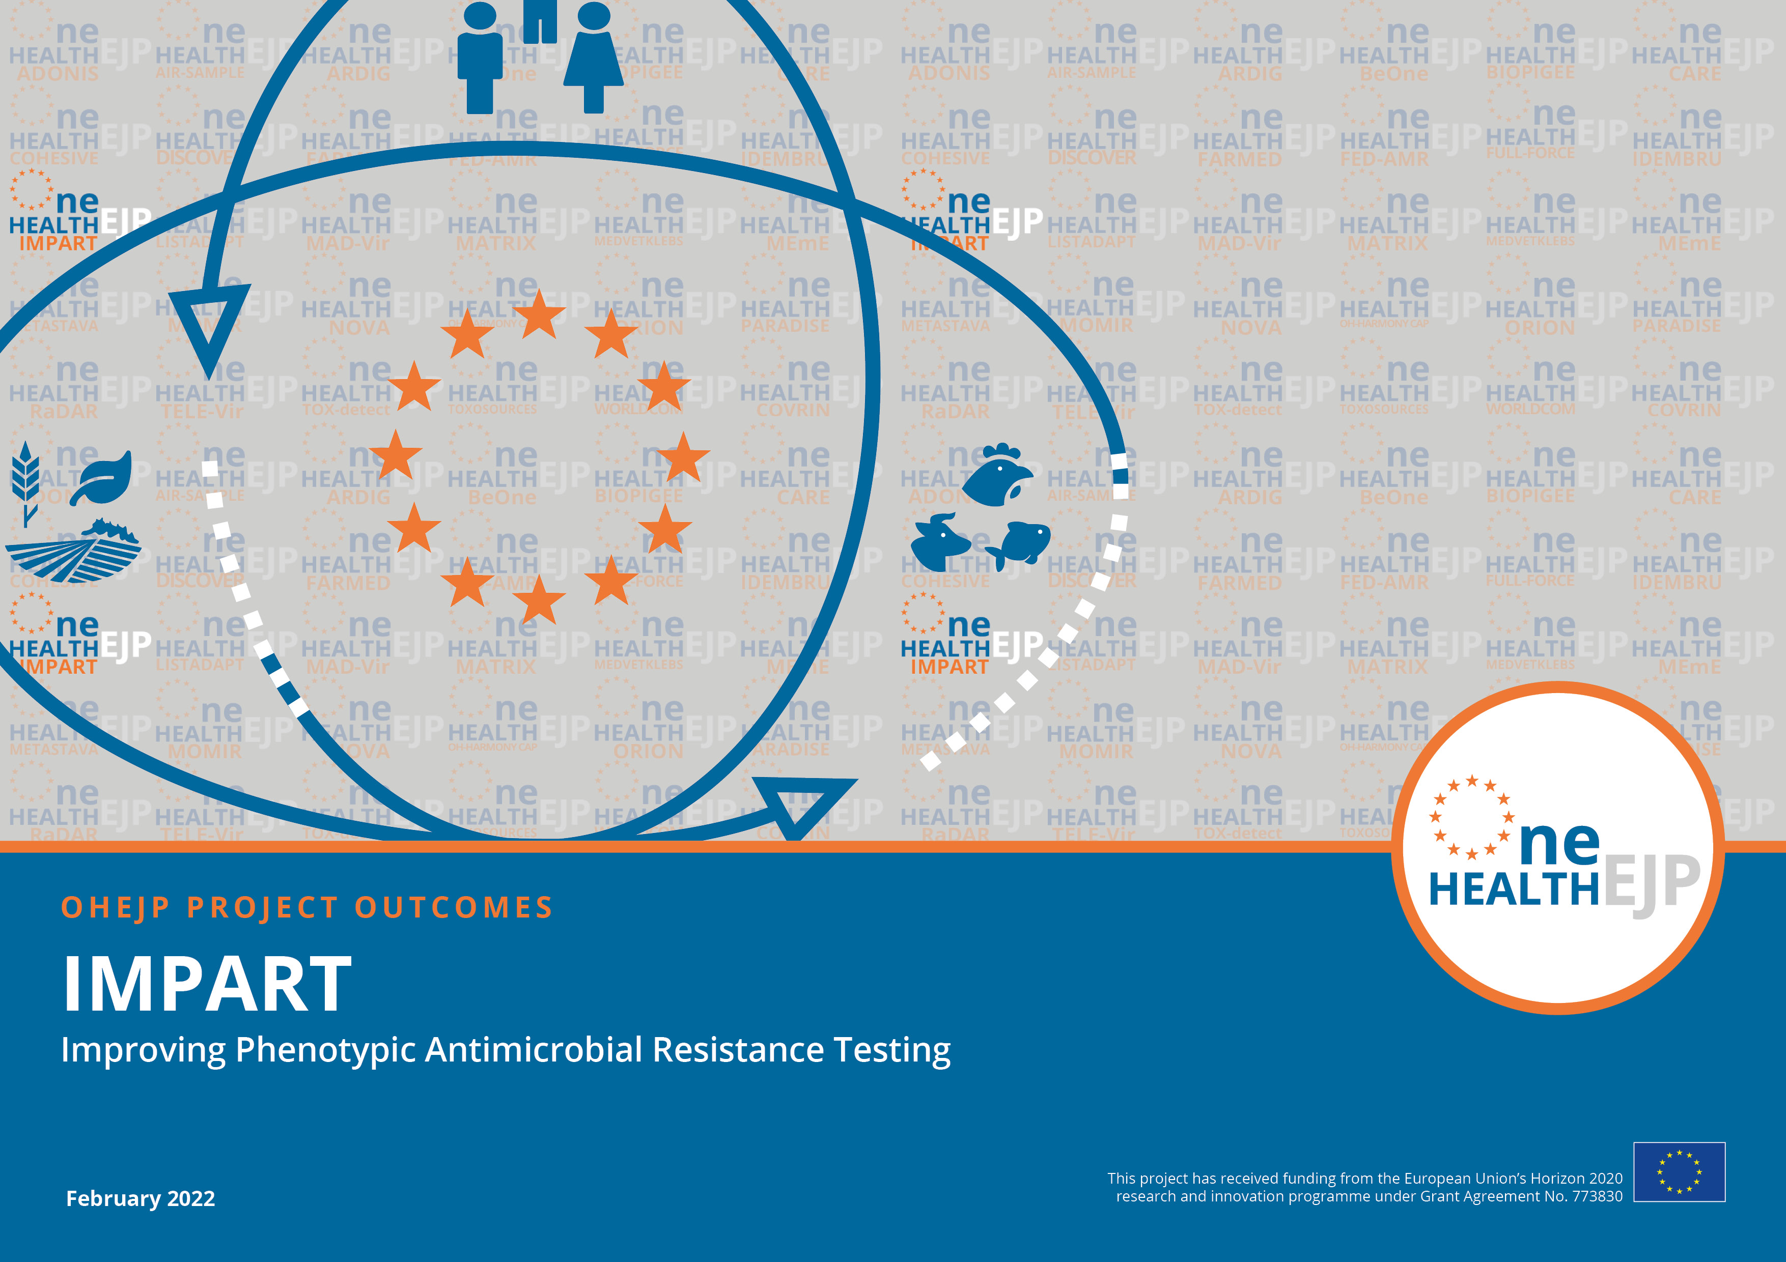
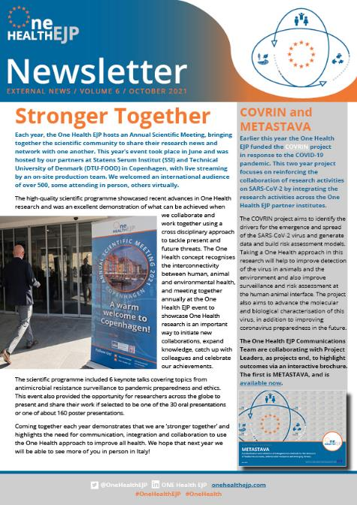
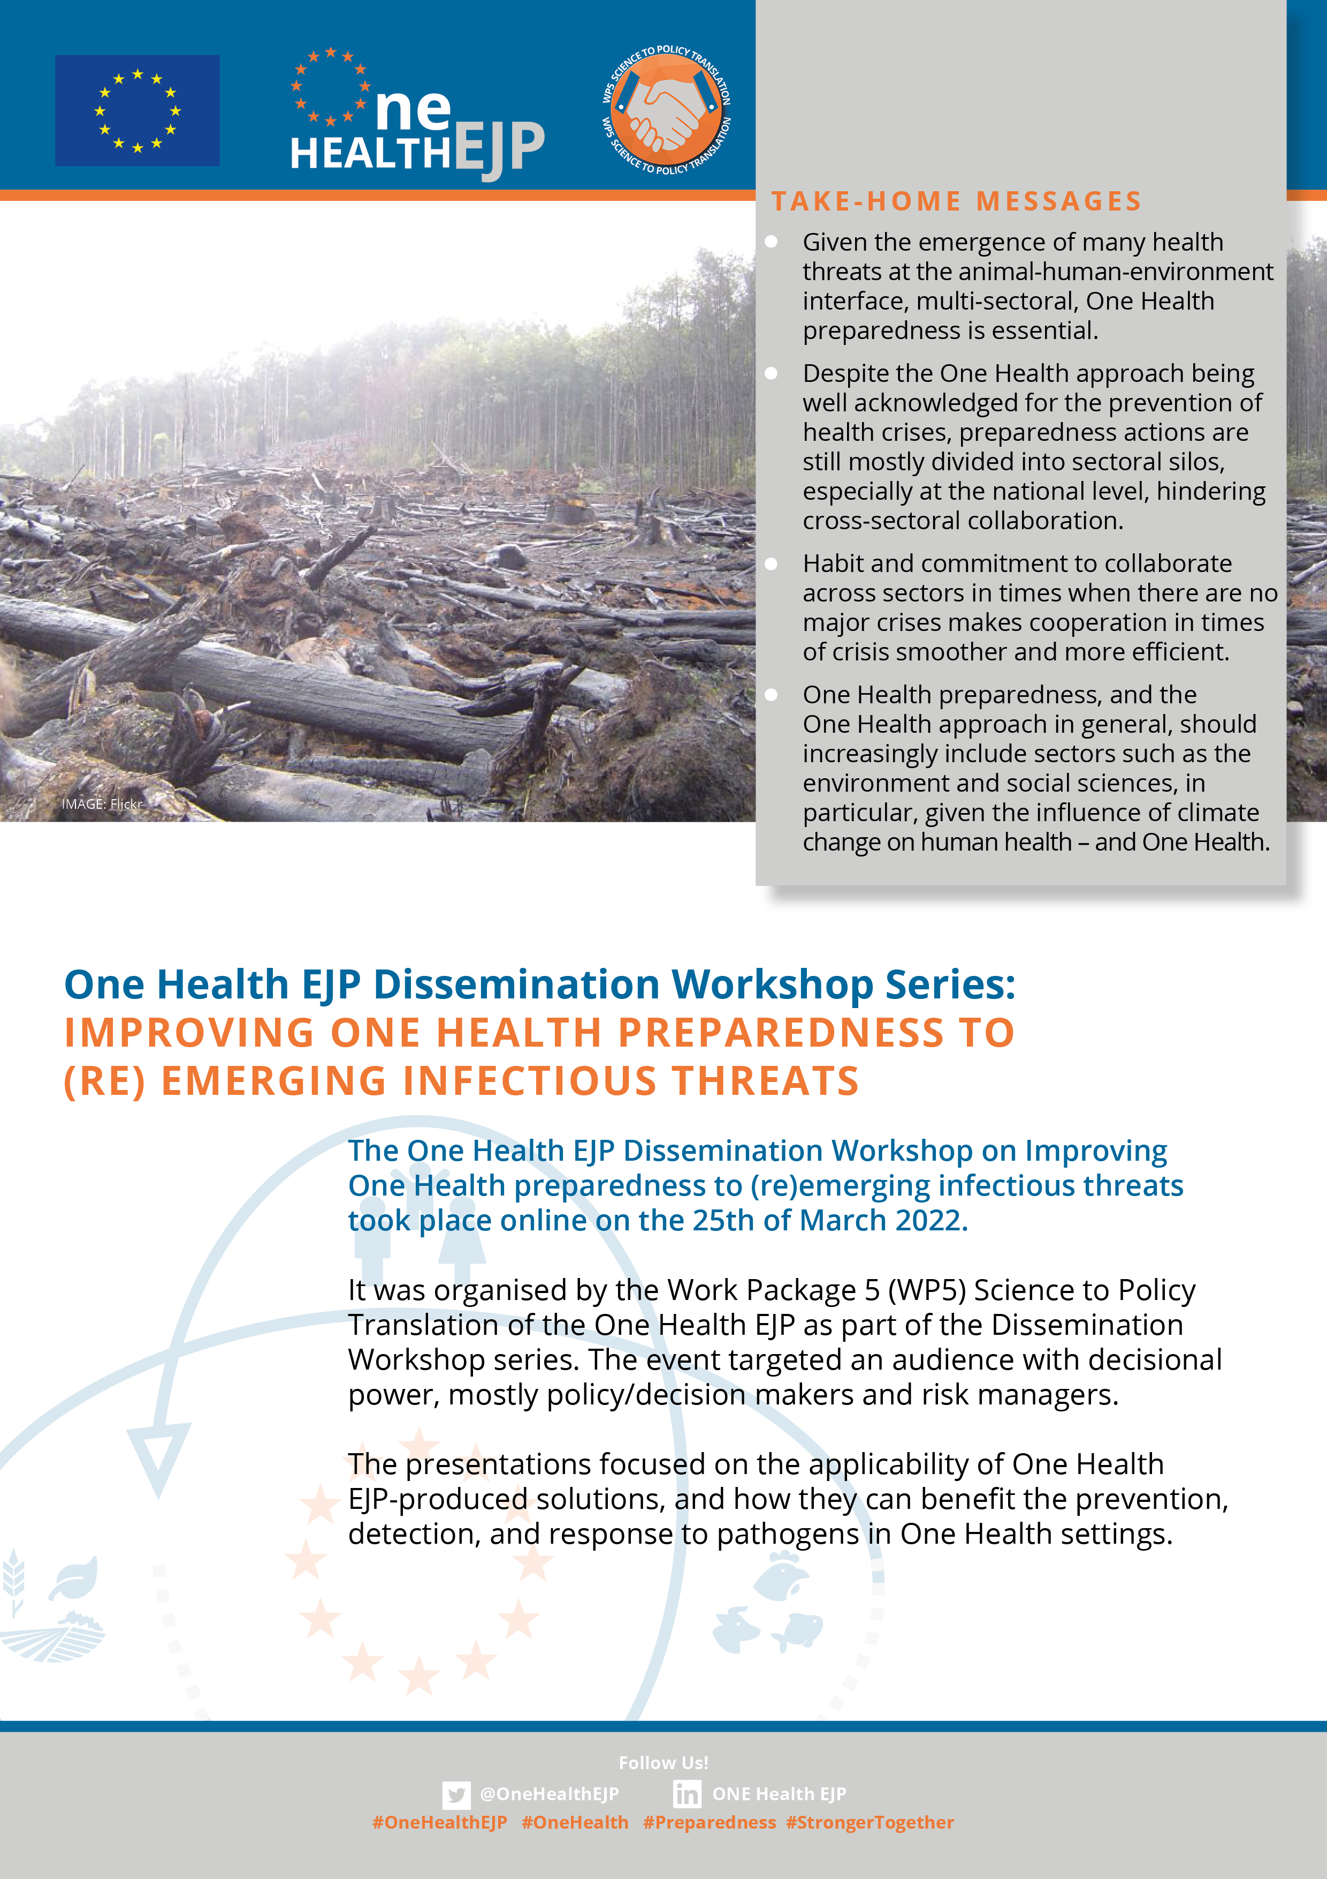

Communication and dissemination tools
To generate the most impact:
    Bespoke end-of-project project brochures.
    Brand-visible social media campaigns with content
    suitable for identified audiences using relevant
    platforms.
    Internal and external newsletters.
    Website frequently updated.
    Disseminating key news taken from
    meetings and events to demonstrate
    One Health EJP impact, project outputs
    and outcomes.
    The Annual Reports.
Supported by strong visual branding and publications on social media.

Slide 17


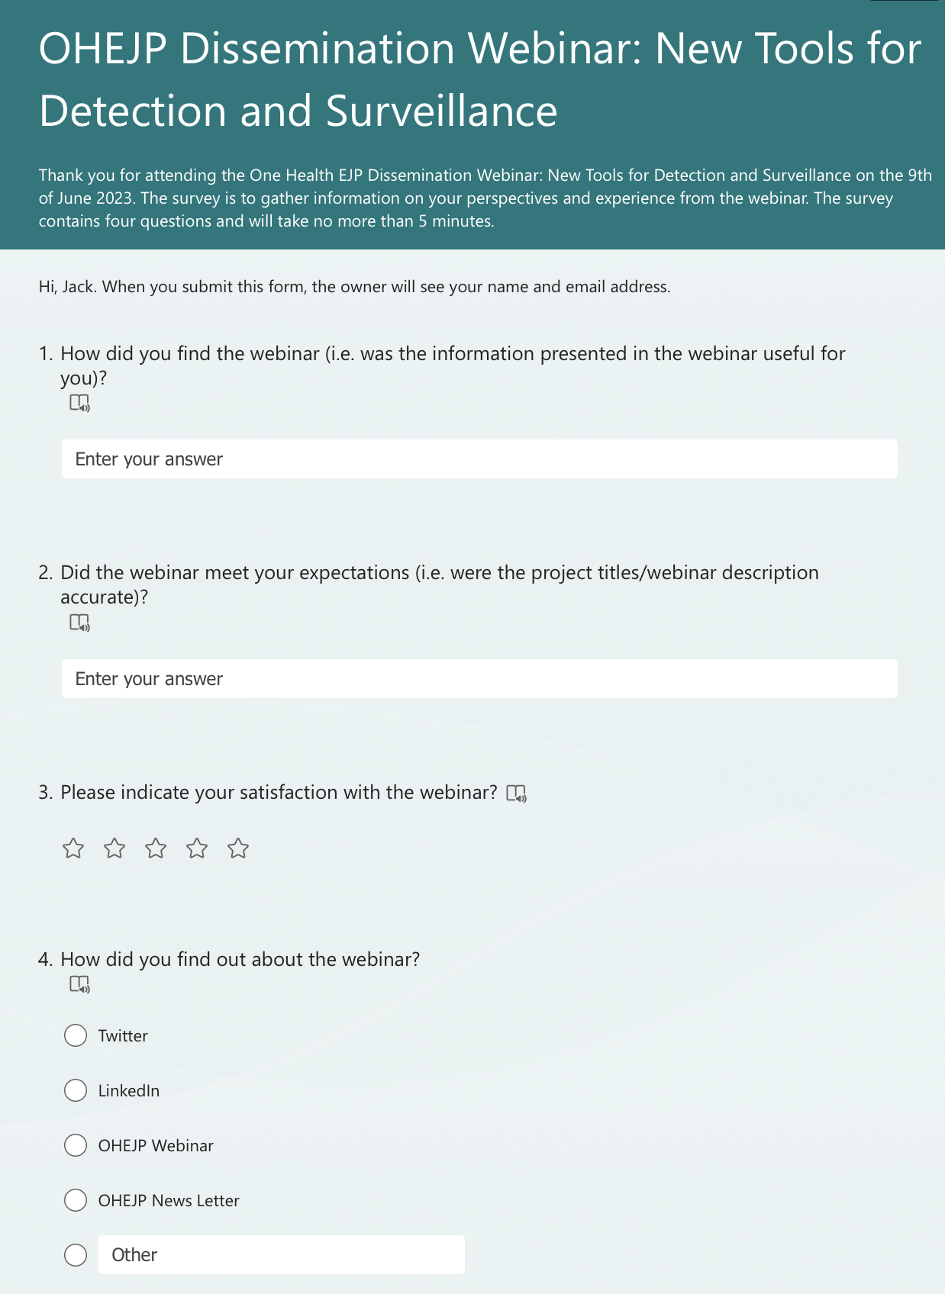



One Health EJP Dissemination Webinar

Slide 18
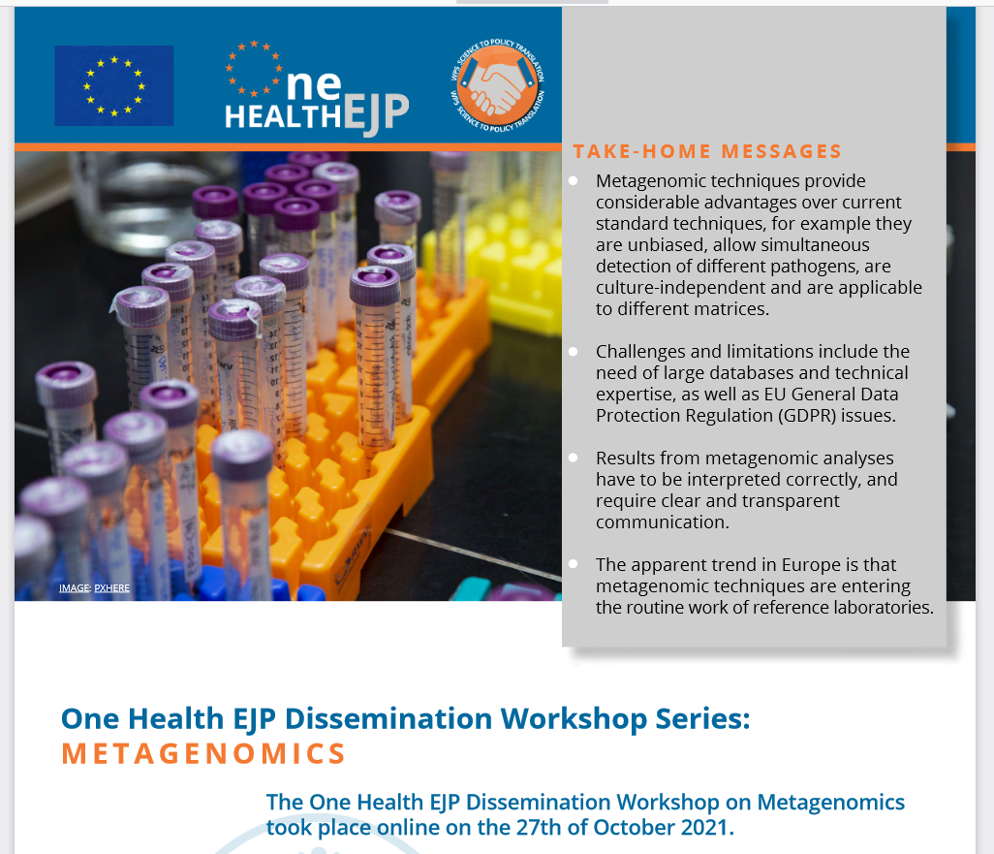
Workshop on Metagenomics
Advantages and challenges of the method
Applications for One Health in the areas of
Antimicrobial resistance
Food/feed safety
Pathogen discovery
Diagnostics
Applications, possibilities and limitations, challenges to overcome, next steps to be taken

Slide 19

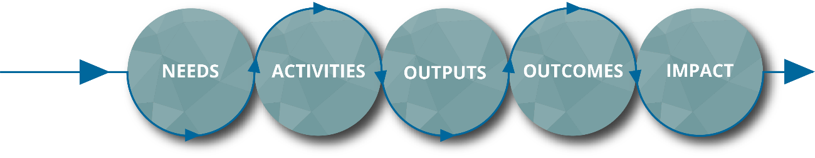

One Health EJP: outward dissemination
ECDC
EFSA
Exchange and communication with
national stakeholders, i.e. the authorities.
But also EU stakeholders.
    European Centre for Disease Control and
    Prevention (ECDC).
    European Food Safety Authority (EFSA).
    Successful outreach to other strategic stakeholders
    and networks: EEA, EMA, FAO, WOAH and WHO-Europe.
Science to policy: feed the evidence based risk assessment and management
of risks by the competent national and European authorities; prevent-
detect-response; support preparedness.
EEA
EMA
FAO
WOAH
WHO-Europe

Slide 20
Working towards impact

Slide 21
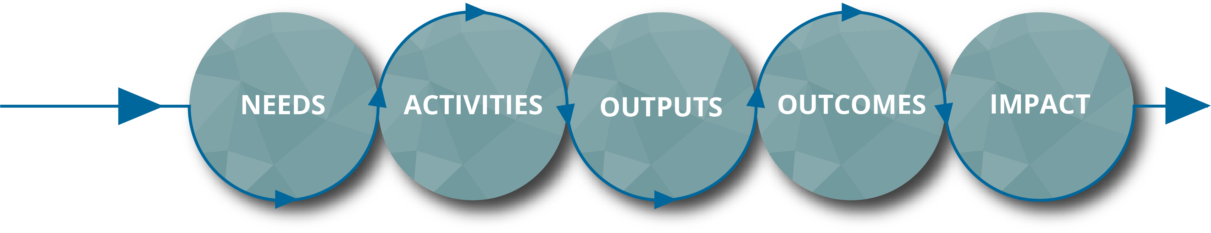

One Health EJP process for impact
THE PROCESS
Strategic
Research
Agenda
Joint Research Projects
Joint Integrative Projects
PhD Projects and all education & training activities
Methods
Epidemiology Tools
Scientific publications
Education & Training
results
Simulation Exercise
PhD theses
One Health implementation in Public Health, Animal Health & Food Safety
New research
Amendment of Stakeholders Policy
Competence building
Strengthened networks
Strategic research and Innovation agenda
Advancement of Science
Increased food safety, improved public health
Sustainable animal production
New EU guidelines, legislation
RESPONSIBLE
FOR ACTION
Project Leaders
Partners
Users
Facilitators
Stakeholders
POC

Slide 22
What is the impact / effect of the work done?
Any project ends up with results, deliverables and output, but should deliver short-term and long-term effects as well, i.e. outcomes and impact.
Areas for successful and sustainable results of the One Health EJP project are science, society and policy, and in some areas economy also.
    Science: new laboratory tests for identification and characterization of microbes, new or improved technologies, new epidemiological data, sources of threats, risk assessment models, etc. for the benefit of others; scientific publications, results as basis for further research projects.
    Society: Food safety, healthy people & animals; in peace time and during outbreaks (during recovery).
    Policy: Advice to authorities, guidelines and instructions, official programmes and laboratory procedures, etc.

Slide 23
Institutionalisation

Slide 24
Roadmap for the institutionalisation of OH
Scan for sectors to be involved in the specific action lines
(medical, veterinary, food, environment, social sciences, economics) and identify the action domains
Identify & Prioritize
Develop a
One Health plan
Set the rules and the data/information flows
Del 7.1: Del 7.4; Del 7.5; SUSTAIN: state of play, SRIA
Facilitate and implement transdisciplinary ways of working
Establish a common language. Harmonize methods and protocols. Develop IT platforms
JRPs; JIPs: capacity building, tools, protocols and IT resources
Build sustainable and impactful engagement
Communicate to the stakeholders and the public, build trust, open data
Establish/adapt and fund governance mechanisms
Identify the roles, identify the funds sources and include in relevant legislation
Notes:
The discussion addressed all the points indicated in the diagram following the scheme below:
Identification and prioritization of representatives of the different sectors.
Development of a One Health plan to define the rules and the flow of information among sectors.
Facilitating and implementing cross-sectoral collaboration.
Define policies for data management and communication.
Design the most appropriate governance mechanisms
Prioritize the sectors to be involved, (environment and social sciences).
Design a plan with clear rules and responsibilities as well as the flow of information.
Define a policy for the data. FAIR (Findable, Accessible, Interoperable, Reusable) data is better than open data (must be part of the data plan and developed at a very early stage).
Implement the tools part of the OHEJP portfolio to establish surveillance systems, cross sectoral data integration and analysis platforms, harmonization of diagnostic and characterisation methods including the use of reference materials and the scheme for interlaboratory studies.
Encourage the development of education plans specifically dedicated to the One Health. Such plans should also include programs for teaching the ability to explain the One Health approach to stakeholders with a non-scientific background (e.g. civil society, policy makers).
Define the communication strategies. Inclusion of professionals not only from the science domain would facilitate the disclosure of the One Health approach to the civil society and, more importantly, to the policy makers, for them to understand the benefits related with its adoption.
Advocate for the One health approach to be explicitly mentioned in the relevant legislation.
Conclusions of a discussion forum
Lack of inclusion of the environmental sector
Absence of a legislative framework and of ad hoc investments
Obstacles establishing effective cross-sectoral collaboration: lack of awareness of the benefits, of concrete One Health strategies, cross-sectoral integration perceived as invasion of sector-specific domains.

Slide 25
Sustainability

Slide 26


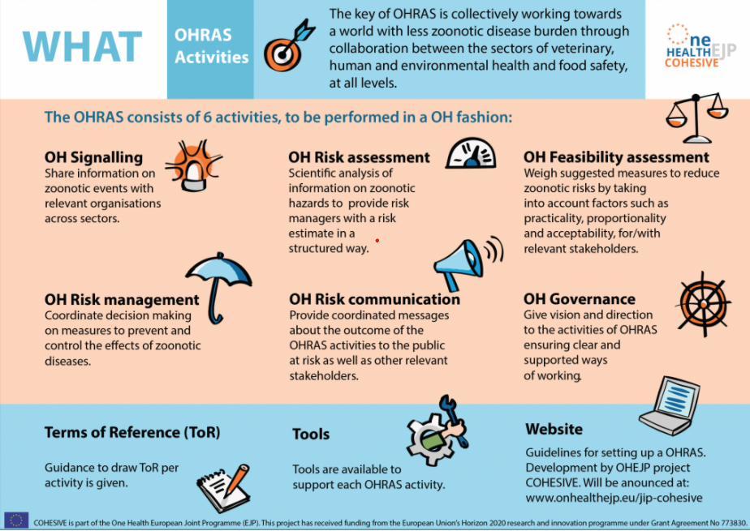

What is the future of the One Health EJP?
The OHEJP project has expanded the European One Health network and has given a huge boost to One Health collaboration in Europe!
How to achieve sustainability of OHEJP outcomes and activities?
How to maintain the European One Health network beyond the lifespan of OHEJP ?

Slide 27
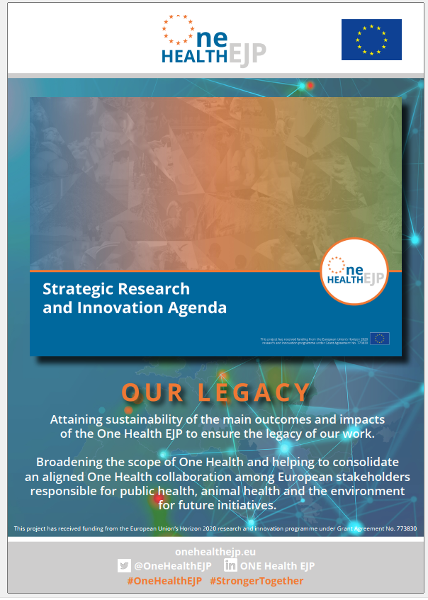
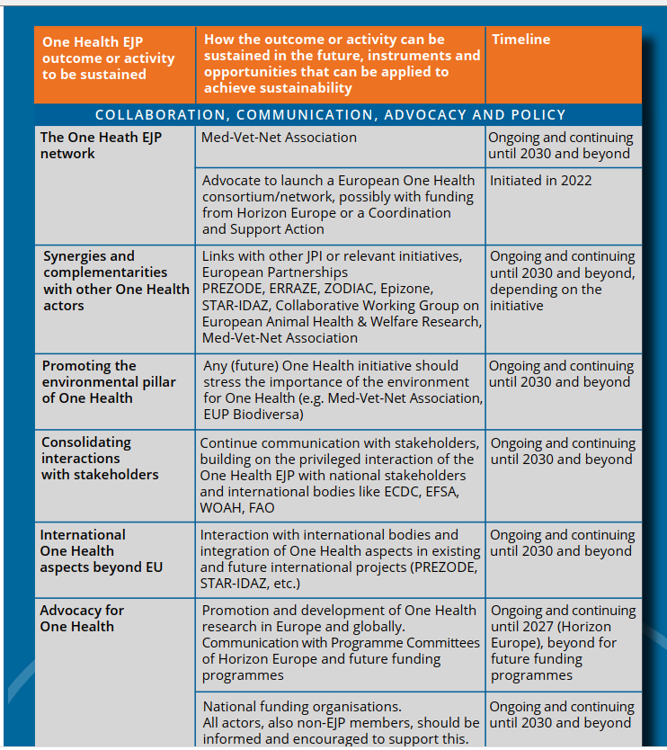
The One Health EJP
Strategic Research and Innovation Agenda (SRIA)
Sustainability plan of the OHEJP: Priority outcomes and activities important to sustain in the future, instruments and opportunities to sustain them and timeline for the future

Slide 28
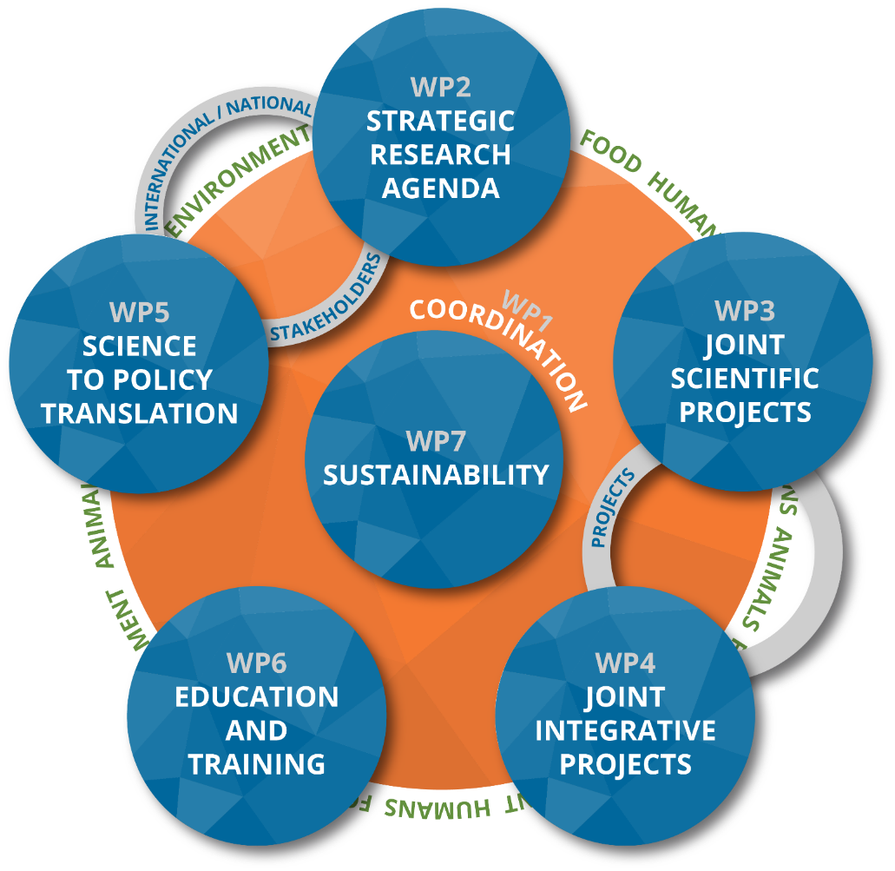

One Health EJP: sustainability
To develop a credible strategy for the years
to come, i.e. SRIA.
To foster strong relationships and thus
creating a solid base to improve and
consolidate integrative actions among
One Health EJP partners.
Role of MedVetNet Association as a legal entity;
future forum for One Health activities, where multi-disciplinary
research consortia with heterogeneous funding
sources cooperate and exchange expertise across
sectors and across borders to strengthen integrative
activities of all actors involved.

Slide 29
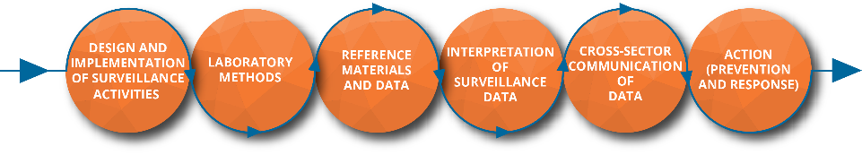
The legacy of One Health EJP
The concept and organization of the One Health EJP, plus its communication and dissemination efforts, reflect its added value:
    Unique European network of public health /
    animal health / food safety organizations,
    increasing ‘OneHealthness’ of its partners;
    Results and outcomes with significant cross-sector value;
    Alignment with national and international stakeholders;
    Oriented towards uptake & impact.
The One Health EJP partners and stakeholders agree that there is a need for a comprehensive and stable European One Health network of public institutions involving all the One Health domains: public health, animal health and the environment; at present such a network does not exist.

Slide 30


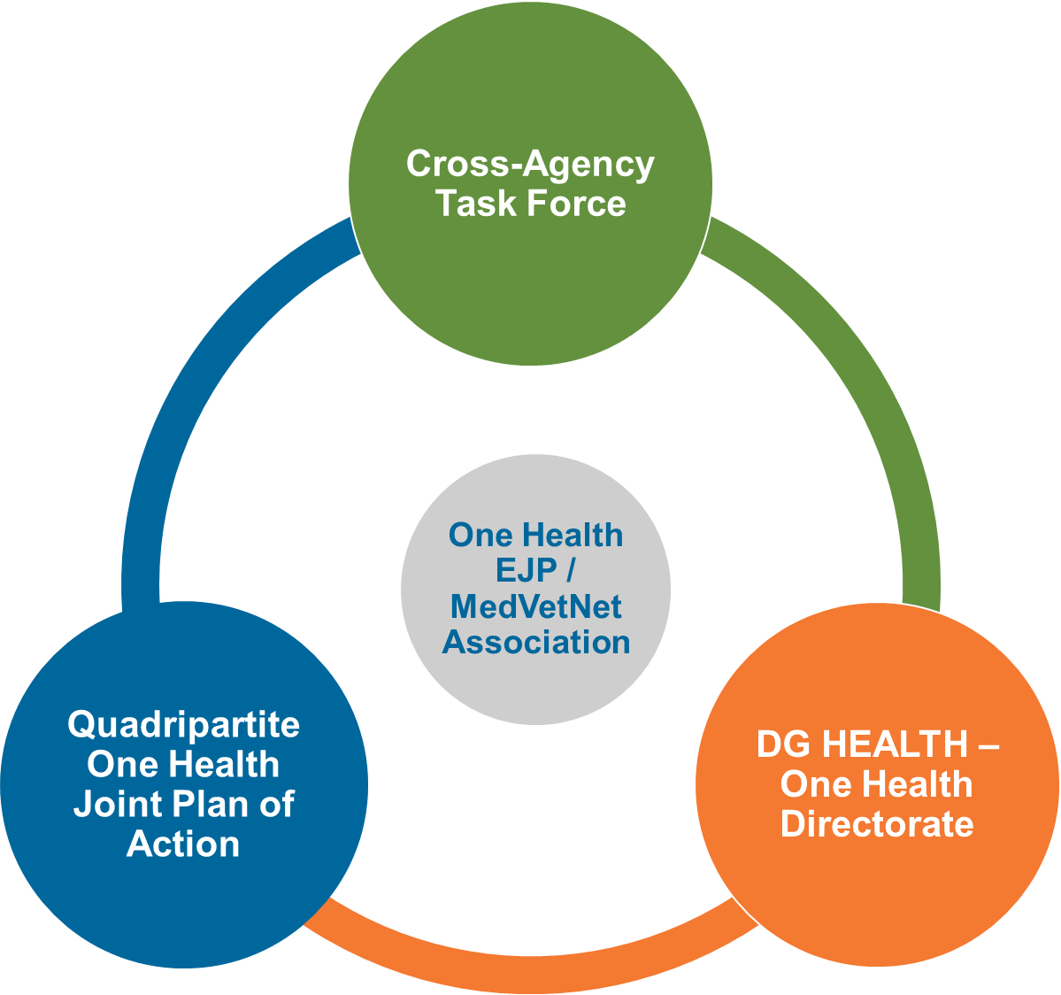
The legacy of One Health EJP
Despite the COVID-19 crisis: creation and consolidation of specific (FBZ, AMR, ET, parasitology) networks, supporting integrative activities like capacity building, sharing of data, strengthening prevent-detect-response (see the Integrative Strategy Matrix).
The One Health outcomes fit into
-and likely support- the objectives
of the Cross-Agencies Task
Force, the One Health Joint
Plan of Action of the
Quadripartite and the
DG-HEALTH Directorate
One Health.

Slide 31




















































One Health collaboration:
crucial for effective prevention, detection and control of (emerging) zoonoses and AMR

Slide 32
Take-home message
The One Health EJP has many valuable outputs and
possible outcomes.
Regional and national programme owners, laboratory managers, risk assessors and risk managers are invited and encouraged to take up the outcomes; return on investment of public budget.
The cross-sector, One Health approach is very profitable; the existing
Med-Vet/Food network is an excellent basis for a unique European
One Health consortium!
    As legal entity, the MedVetNet Association
    offers its partners a convenient European
    One Health forum and continue the uptake
    of practical One Health outcomes.
    The environment dimension will be further reinforced.

