Slide 1
Activities and the new AMR roadmap for the WHO European region – From evidence to action
Dr Danilo Lo Fo Wong Regional Adviser Control of Antimicrobial Resistance
Cross-Sectoral One Health Conference on Antimicrobial Resistance, Riga, Latvia, 7 December 2023

Slide 2
Presentation outline:
From Action Plan to Roadmap
WHO Regional activities
Why an AMR Roadmap (2023-2030)
Process for development
AMR Roadmap
Operationalizing the AMR Roadmap

Slide 3
European strategic action plan on antibiotic resistance (2011 – 2020)
WHO European action plan adopted by all 53 Member States
Recognizing
AMR neglected in many countries of the region
No systematic AMR surveillance in large part of the Region
Need for intersectoral coordination
Need for international standards and data sharing
International spread through travel and trade

Slide 4
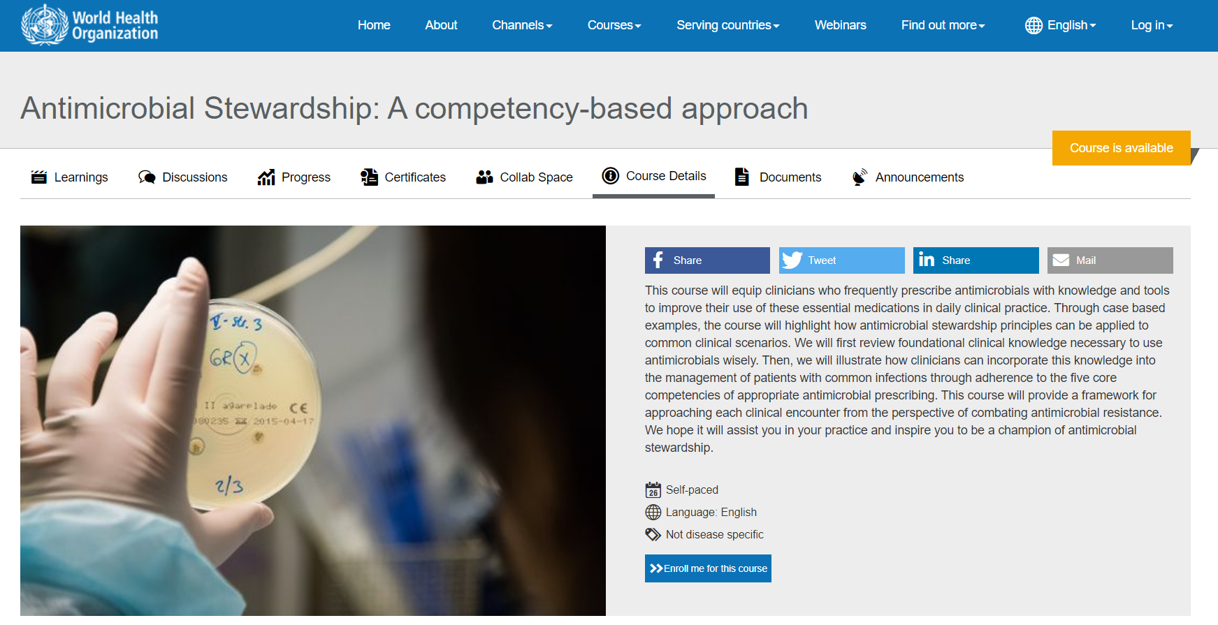
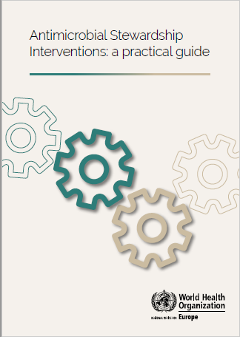
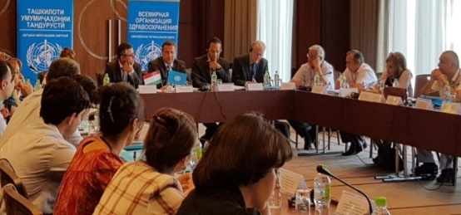
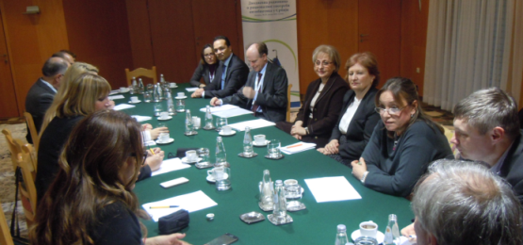
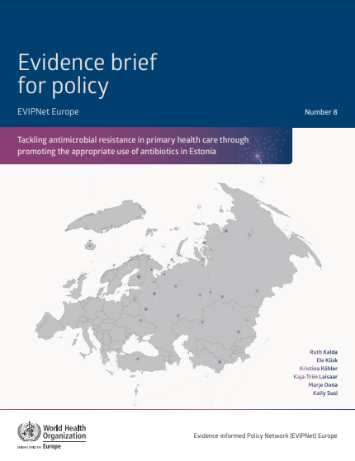
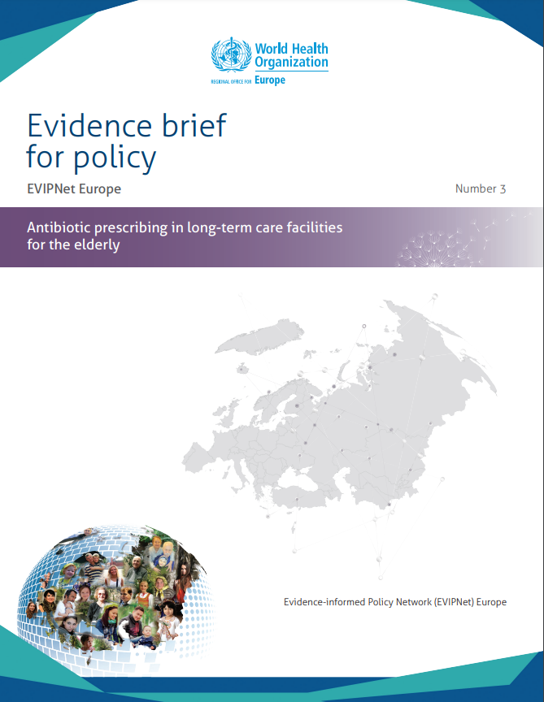
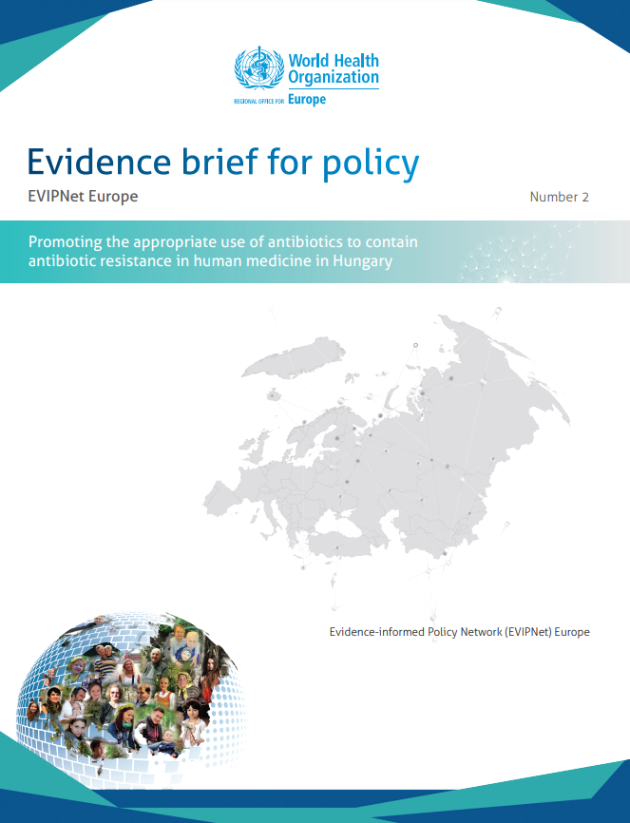
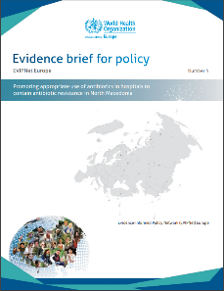
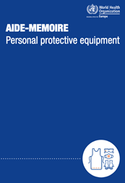
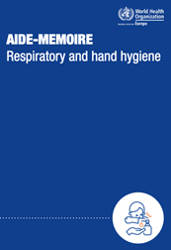
Regional WHO initiatives
National Action Plan implementation support at country level
Policy support
Training and education of healthcare workers
National stakeholder meetings
Intersectoral Coordination Mechanism
National AMR action plans
Evidence-informed policy briefs
Antimicrobial stewardship
Infection prevention and control

Slide 5
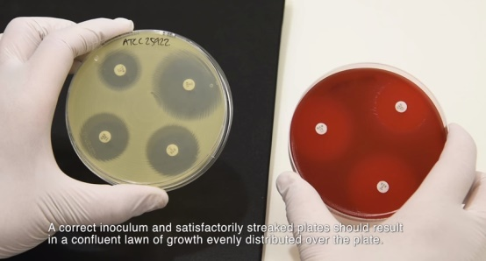
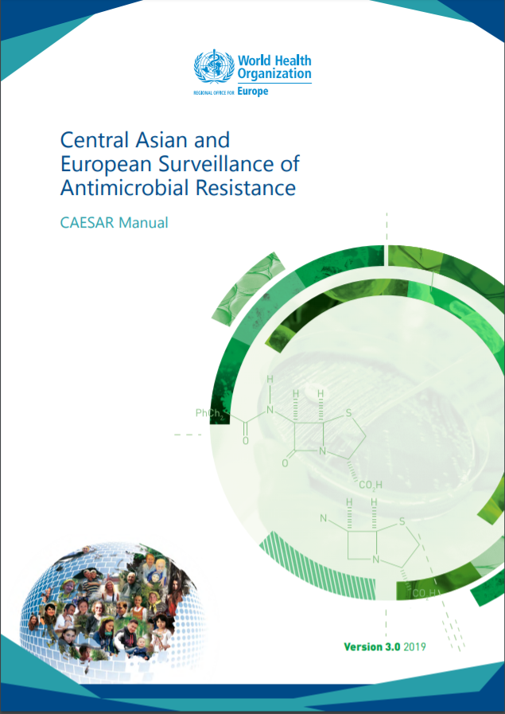
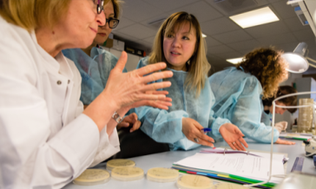
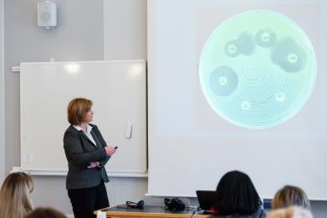
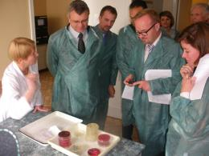
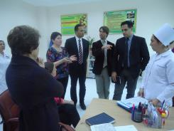
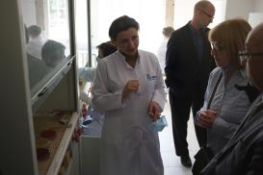
Regional WHO initiatives
Technical support at country level
Surveillance capacity building
Technical resources
Laboratory quality management and mentoring
Standardized laboratory methods
AMR and AMC data collection, recording, management, analysis and reporting
Protocols, templates, tools, videos, manuals
Consultants/experts
Research / projects / studies / surveys

Slide 6
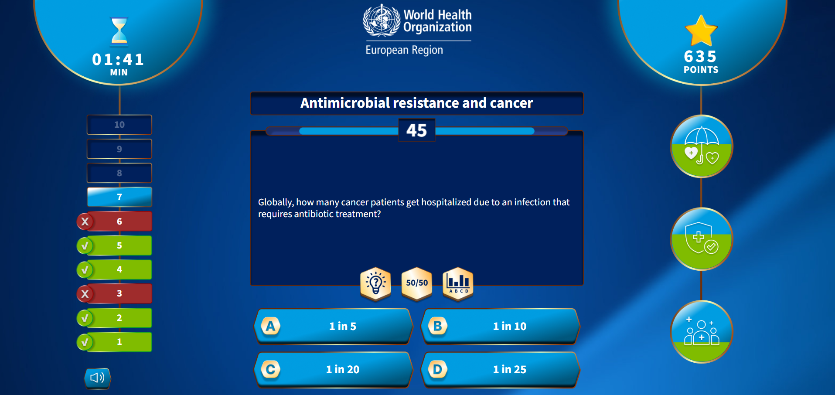
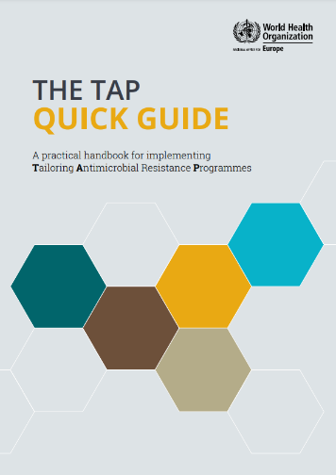
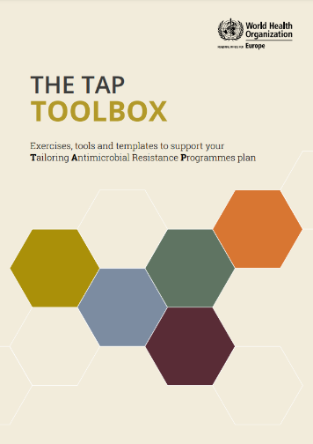
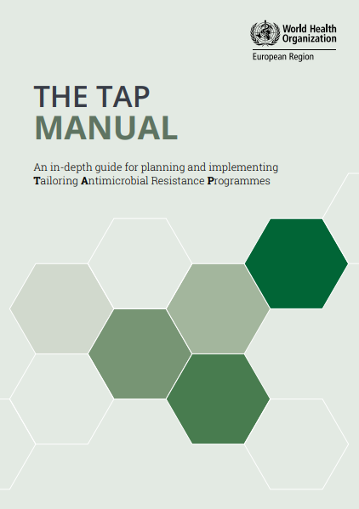
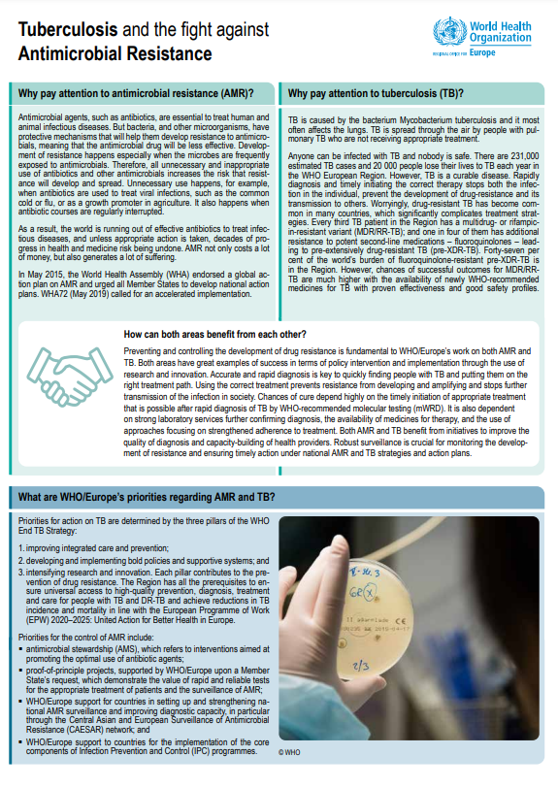
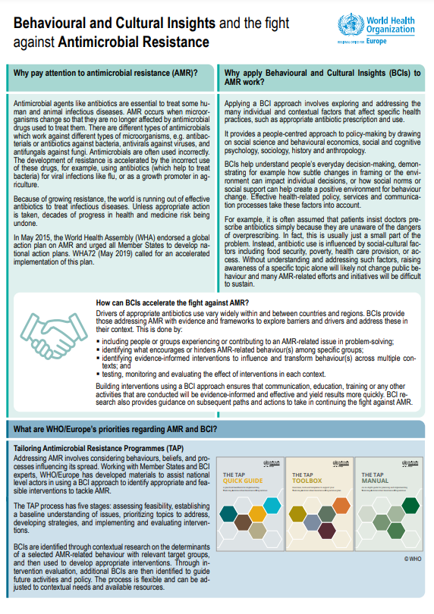
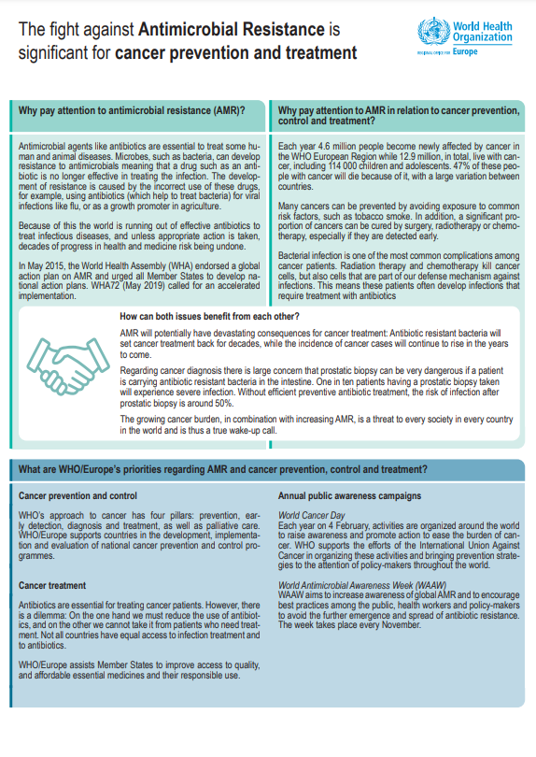
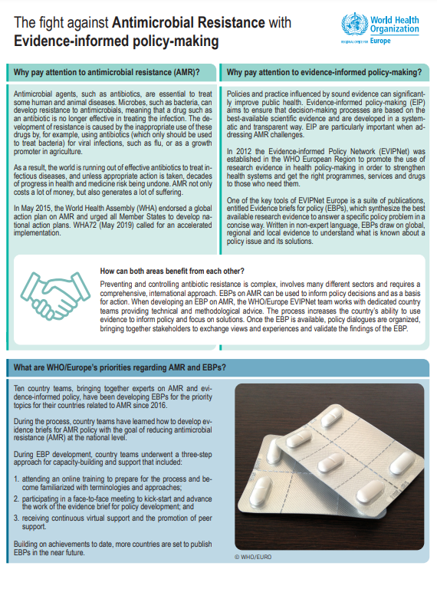
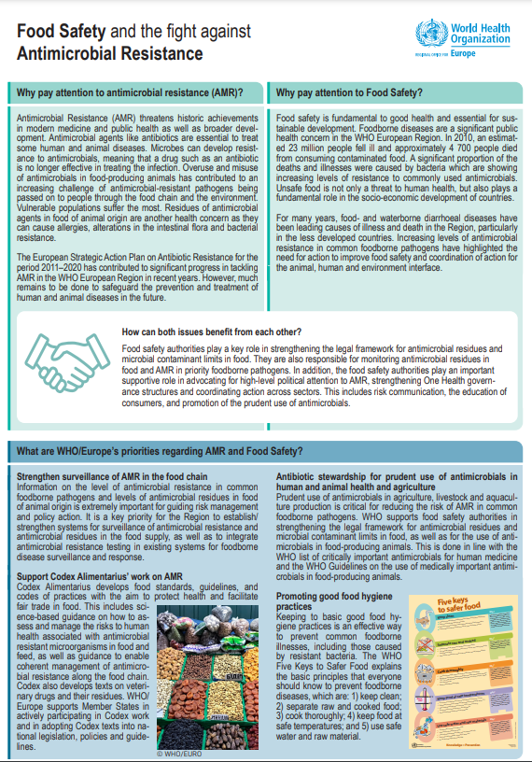
Regional WHO initiatives
Awareness, advocacy and behaviour
Awareness and advocacy
Behavioural and cultural insight
World Antimicrobial Awareness Week
Advocacy briefs – AMR and …
COVID-19
Food Safety
Better lab quality
Cancer
Health workforce
Migration
Vaccination
Gender
…
Tailoring AMR Programmes (TAP) through behavioural interventions
Behavioural insights projects
Surveys
Trainings and webinars

Slide 7
European strategic action plan on antibiotic resistance (2011 – 2020)
Achievements
AMR no longer neglected in countries of the region
National AMR action plans (44) and intersectoral coordination (46) in most countries
Data from AMR and AMC surveillance from 46 countries
Tools developed and technical support provided
Tripartite collaboration strengthened

Slide 8
AMR

Slide 9
Why an AMR Roadmap (2023-2030)
Most countries have National Action Plans on AMR but feedback includes:
Lack of true leadership and funding
One Health Coordination challenging
Limited linkages with Universal Health Coverage (UHC), Primary Health Care (PHC) and Pandemic Preparedness and Response
Access to timely diagnostics challenging
Surveillance for action needs further strengthening

Slide 10
Process for development of the AMR Roadmap
First draft of the roadmap
AMR Working Group retreat
Internal cross-Divisional input
Technical consultations
External Experts
National focal points and partners
Official MS consultation
Subregional consultations
EU/EEA Member States
Central Asian Republics
Partner briefings
WHO Collaborating Centres
Non-state Actors, Youth Alliances
Adoption of AMR Roadmap at RC73
Technical WHO/Europe programmes consulted:
Control of Antimicrobial Resistance
Food Safety and Zoonoses
Infection Prevention and Control
Laboratory Quality Management
Access to Medicines and Health Products
Centre for Environment and Health
Behavioural and Cultural Insights
Vaccine-preventable Diseases and Immunization
Joint Infectious Diseases
Data and Digital Health
Health Workforce and Service Delivery
Quality of Care and Patient Safety
Centre for Primary Health Care
Gender and Human Rights
Health Systems Financing
Investment for Health and Development

Slide 11
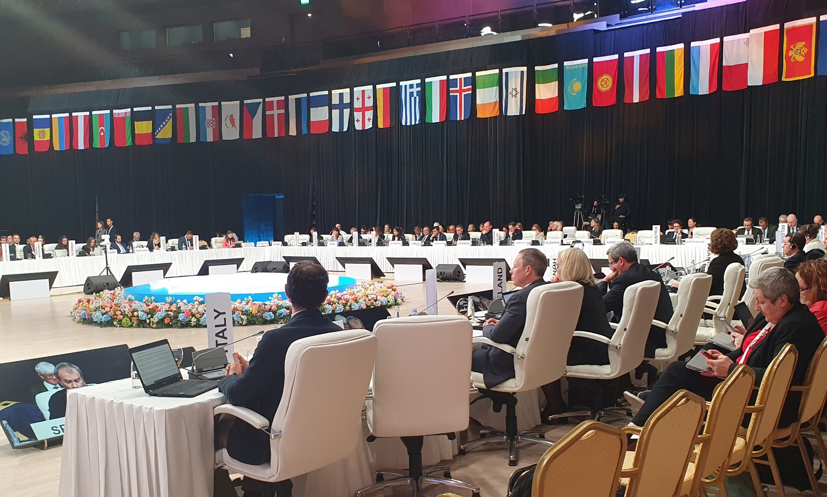
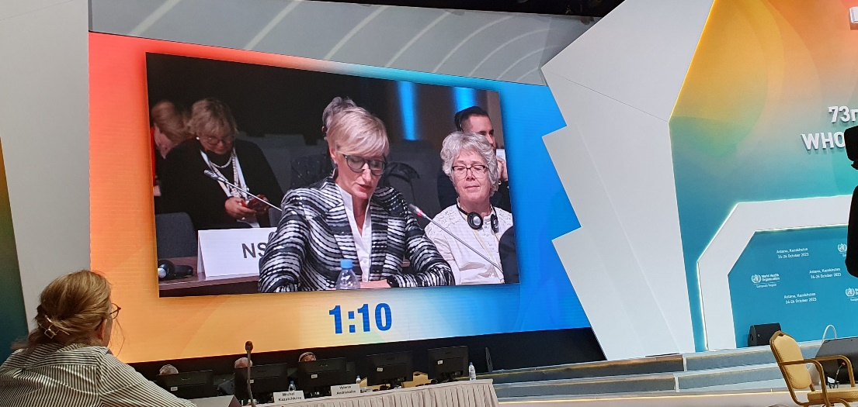
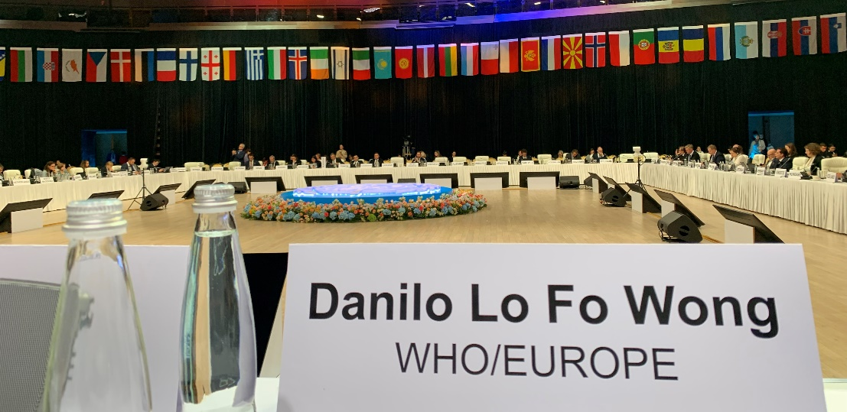
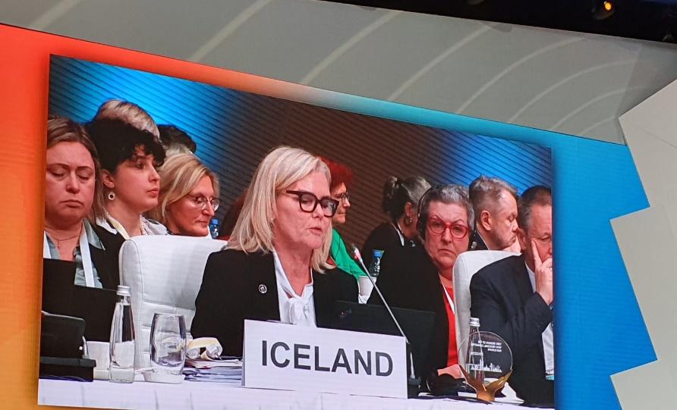
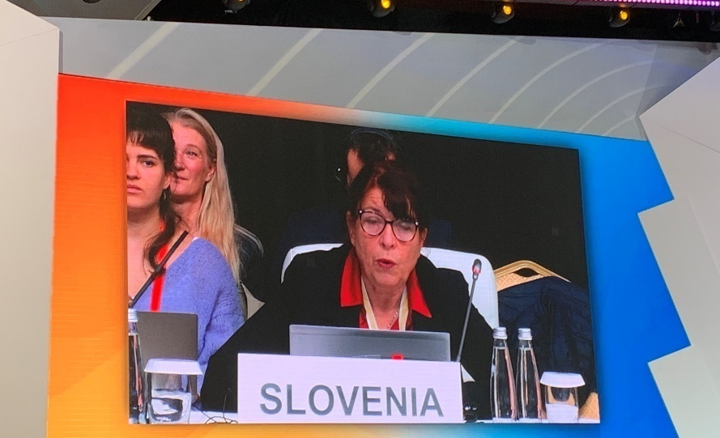

Slide 12
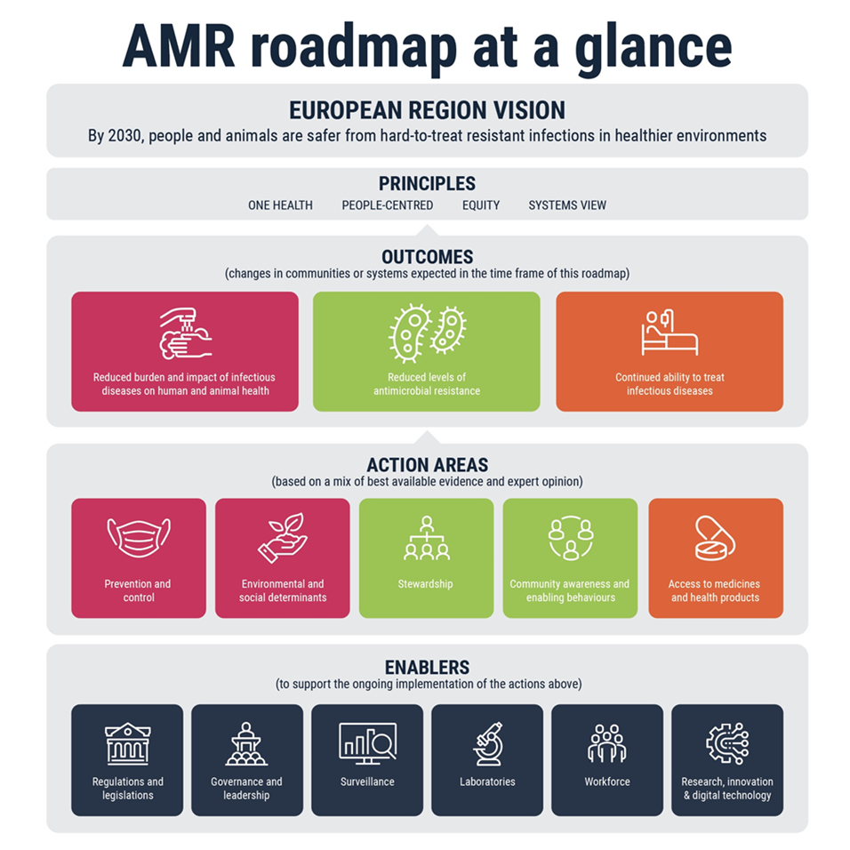

Slide 13
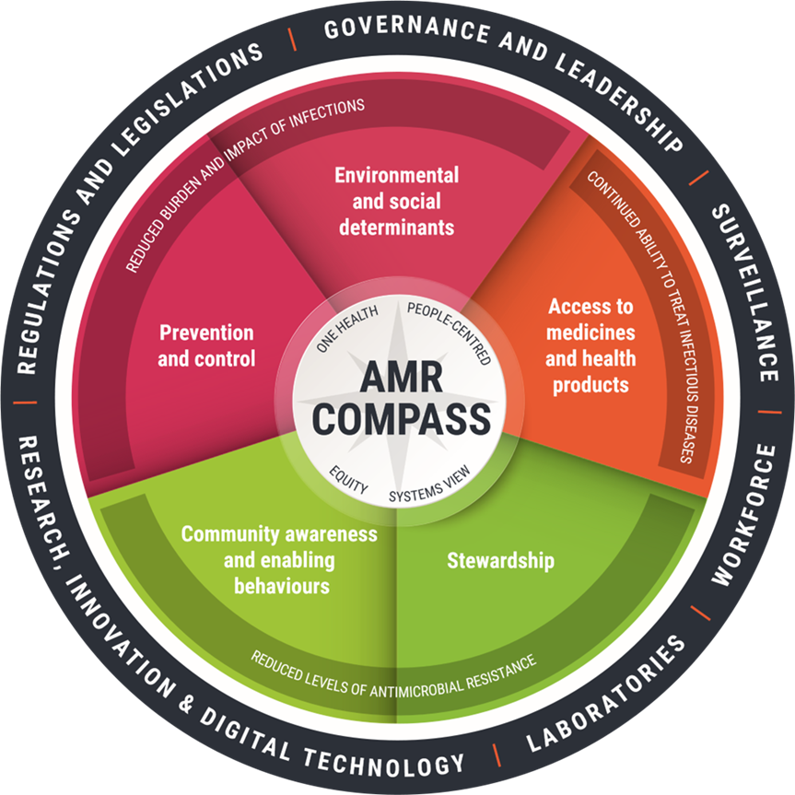
Navigating country implementation - The AMR Compass
Diagnostic tool to:
Assess national AMR capacity
Identify national priorities
Set national targets
Implement evidence-based interventions
Evaluate progress

Slide 14
Action areas
1. Infection prevention and control and water, sanitation and hygiene:
Infection prevention and control in health and care facilities
Water, sanitation and hygiene (WASH) in health and care facilities
WASH in communities
Vaccinations
Food production systems
2. Environmental and social determinants:
Occupational conditions
Collection, treatment and disposal of wastewater
Solid waste management
Housing conditions
Financial protection
Access to basic health services for refugees and migrants
3. Stewardship:
Antimicrobial stewardship programmes
Surgical antibiotic prophylaxis measures
Diagnostic stewardship
Clinical decision support systems to support antimicrobial stewardship
4. Community awareness and enabling behaviours
Communication and advocacy
Awareness and behaviour activities
Engagement of non-State actors
Engagement of primary care and pharmacy teams in the community
5. Access
Access to diagnostics
Access to antimicrobial medicines and vaccines
Access to and prudent use of antimicrobials for animals and plants

Slide 15
Enablers
1. Regulations and legislations
Food safety standards
Antimicrobials for nontherapeutic use
Antifungal use in agriculture
Pharmaceutical promotion
Substandard antimicrobials
Regulatory frameworks for digital health
Regulations and legislations for wastewater and WASH
2. Governance and leadership
Political commitment
AMR One Health coordination and participation.
Resourcing for One Health AMR
Mainstreaming AMR across all One Health plans
AMR as part of preparedness and response plans
Private sector partership
3. Laboratories
Sampling services
AMR reference laboratories
AMR testing capacity and capability
Whole genome sequencing for AMR surveillance
4. Workforce
Workforce strategy and plan
Continuous personal development and education for multidisciplinary teams
Role of pharmacy teams and nurses
Laboratory expertise
5. Research, innovation and digital technology
Public incentives for public and private sector innovation
Research – generating and promoting the use of evidence on AMR and its impacts
Implementation research
Digital health technologies
6. Surveillance
Surveillance of AMR and AMU in humans
Surveillance of WASH services
Environmental surveillance of wastewater and surface water
Surveillance of AMR and AMU in animals and plants
Integrated surveillance

Slide 16
Operationalising the Roadmap
At country level, WHO/Europe and partners will:
Advocate for AMR to be a national priority
Facilitate One Health policy dialogues using the AMR Compass to set baseline and direction
Guide prioritising and target setting
Provide technical support for action plan implementation

Slide 17
Operationalising the Roadmap
At regional level WHO/Europe will:
Create a platform for inter-country exchange of best practices and capacity building
Create an active network of national AMR focal points
Convene stakeholder forums dedicated to action areas of the roadmap
Define indicators for step-wise implementation
Measure regional progress through a monitoring and evaluation framework for the roadmap

Slide 18
WHO/Europe year-long social media campaign with AMR stories from across the Region

Slide 19
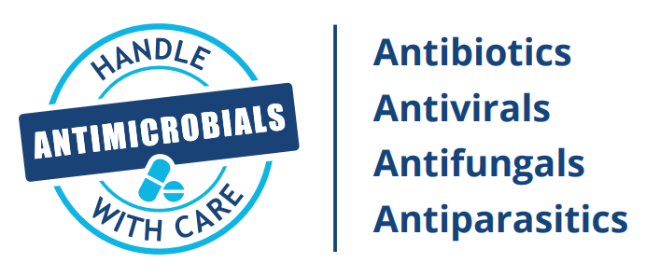
Take the
QUIZ
and test your
AMR knowledge

Slide 20
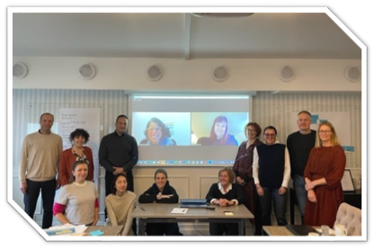
Thank you for ​your attention​
4

